Slide 1
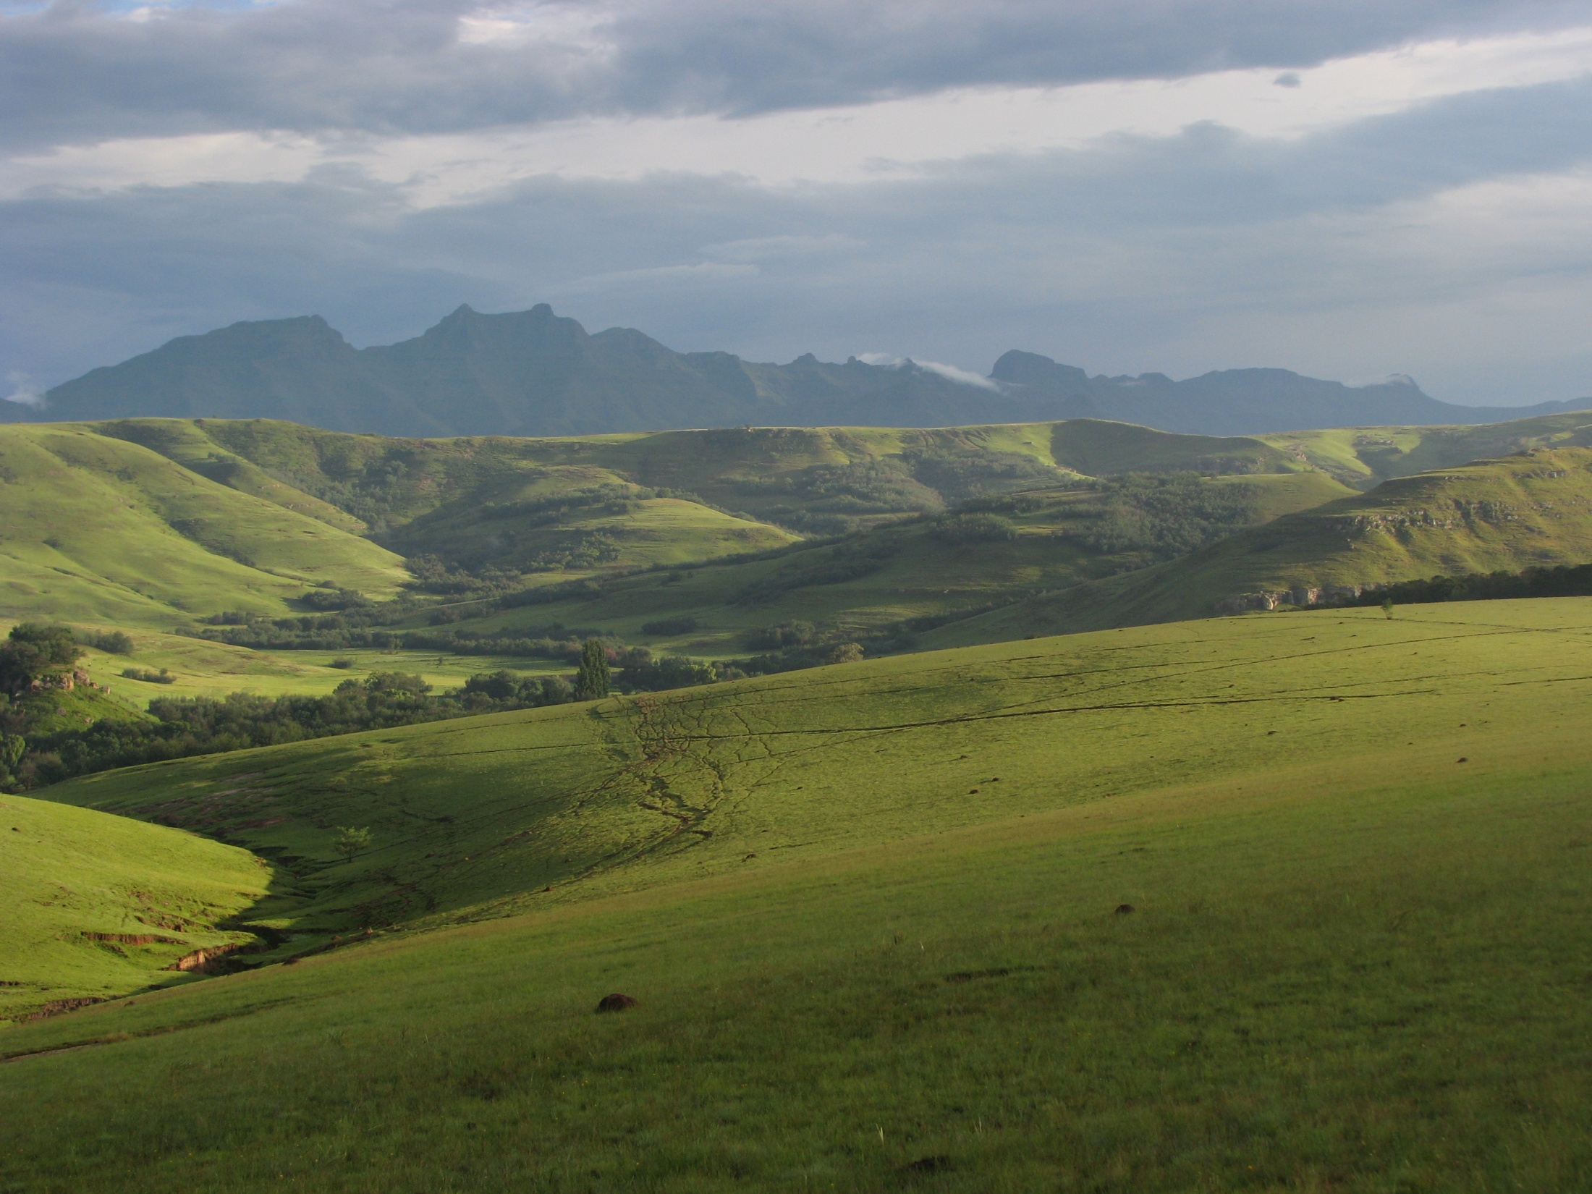


OIL & GAS PROSPECTING:
WHAT’S IN IT FOR MATATIELE?

Slide 2
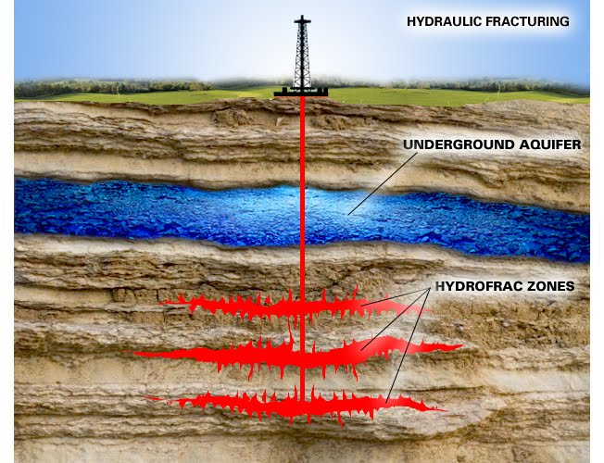
BE INFORMED, NOT FOOLED
LEGAL APPLICATION PROCESS
WHY EXPLORATION?
IMPACTS OF EXPLORATION PHASE
IMPACTS OF PRODUCTION PHASE
WHAT DOES ‘FRACKING’ ENTAIL?
WHAT ARE THE BENEFITS & RISKS?
WHAT ARE OUR ALTERNATIVES?

Slide 3

MATATIELE
Where Nature, Agriculture & Tourism are Investments of Choice
Mission Statement
To create awareness of nature conservation, to promote and support agricultural activities, to promote & market Local Tourism Organizations and Small Medium and Micro Enterprises.

Slide 4
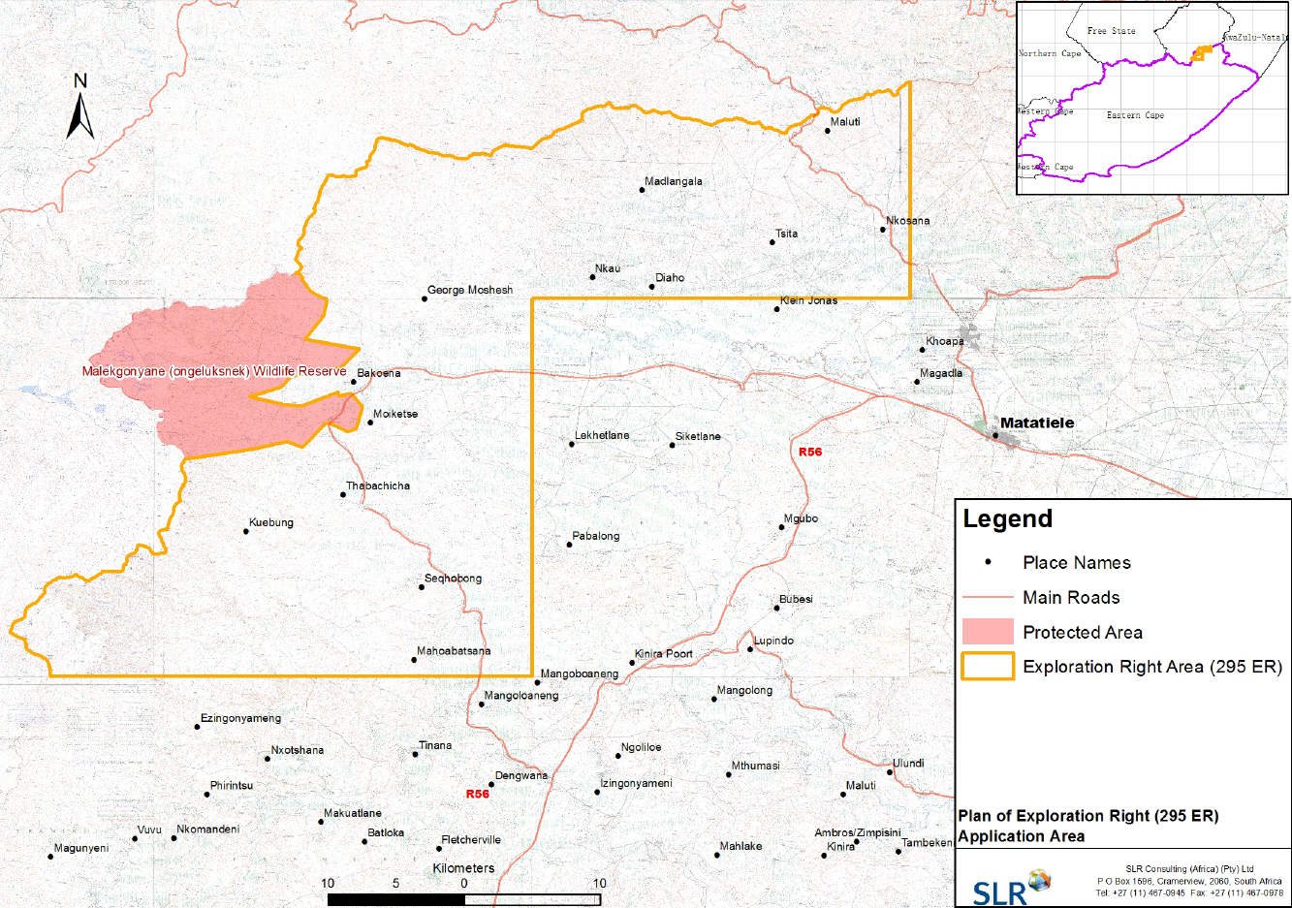

Slide 5
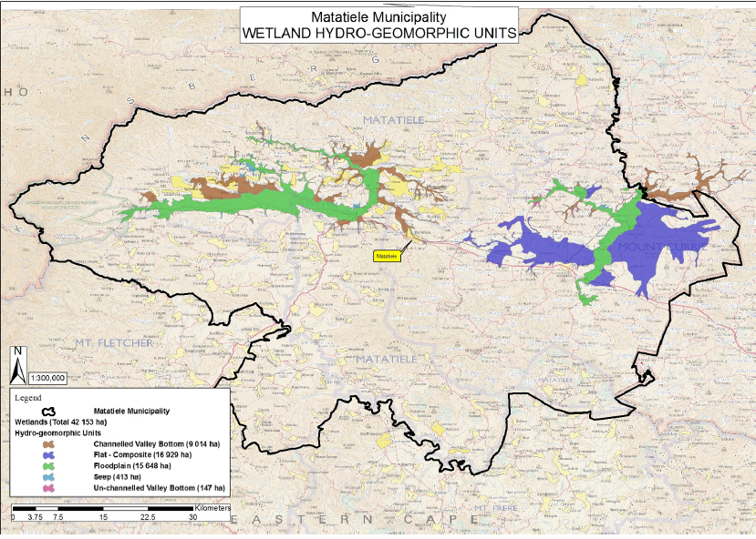

Slide 6
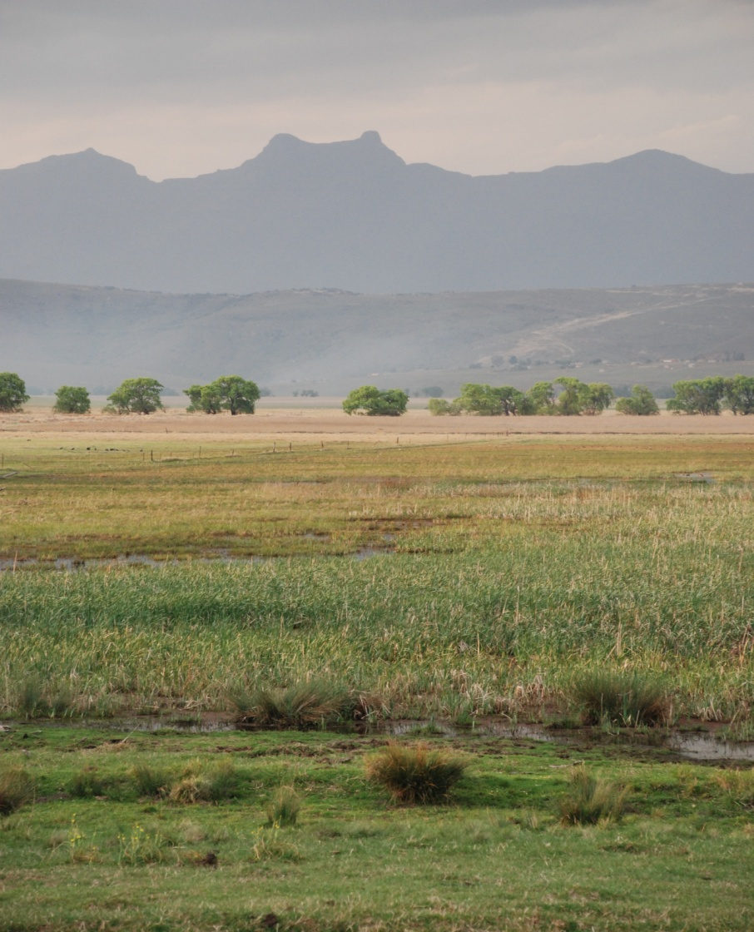
R27 million Estimated value of water production per year from upper Matat catchment

Slide 7
APPLICATION PROCESS
EXPLORATION PERMIT
PRODUCTION RIGHT
EIA for permit to survey
EIA includes public consultation….
3 years for survey
Drill 10 core test holes
125km Seismic test lines with blast holes
Determine if viable sources exist
EIA for production right
WATER USE LICENSE
WASTE LICENSE
AIR EMISSIONS LICENSE
Drilling & and associated activities for 5 years, including possible fracking
Rehabilitation and compensation????

Slide 8
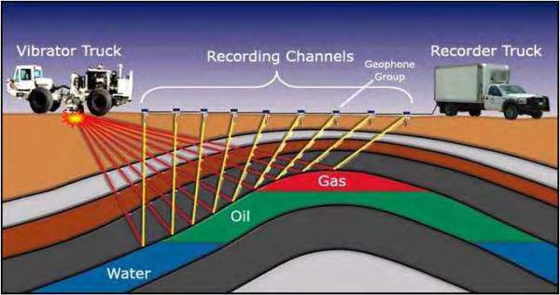
POTENTIAL IMPACTS of EXPLORATION
EXPLORATION
Seismic impacts on soil and water; vibrations and noise
Lots of trucks: road and carbon impacts
Access and safety onto land by outsiders
Drilling cores: disturbing boreholes and contaminating water sources
Economic boost for Matat? 25 short term specialists from outside
“The explosive-shot seismic surveys drilling of shallow holes (5 to 30 m in depth) at a regular spacing (20 to 200m
intervals) The hole is loaded with an explosive charge backfilled and the charge is set off with the recording in progress. If a blast crater is made this is backfilled immediately. The vibratory method uses large Vibroseis trucks with plate that is lowered to the ground at a regular intervals to vibrate the ground. Can be felt 50m away”

Slide 9
Mitigating exploration impacts
A well site where hydraulic fracturing operations are proposed or planned, must not be located-
(a) within 5 kilometres, measured horizontally, from the surface location of an existing municipal water well field and identified future well fields and sources and directional drilling may not be within 2.5 kilometres of municipals well field;
(b) within 500 metres, measured horizontally, from the surface location of an existing water borehole and directional drilling may not be within 500 metres of the borehole; and
(c) within 500 metres, measured horizontally, from the edge of a riparian area or within 1:100 year flood -line of a watercourse.
A well may not be drilled within 1 kilometre of a wetland.
Delineate / buffer boreholes, protected areas, water sources, wetlands, riparian zones : no space left to explore or produce legally

Slide 10
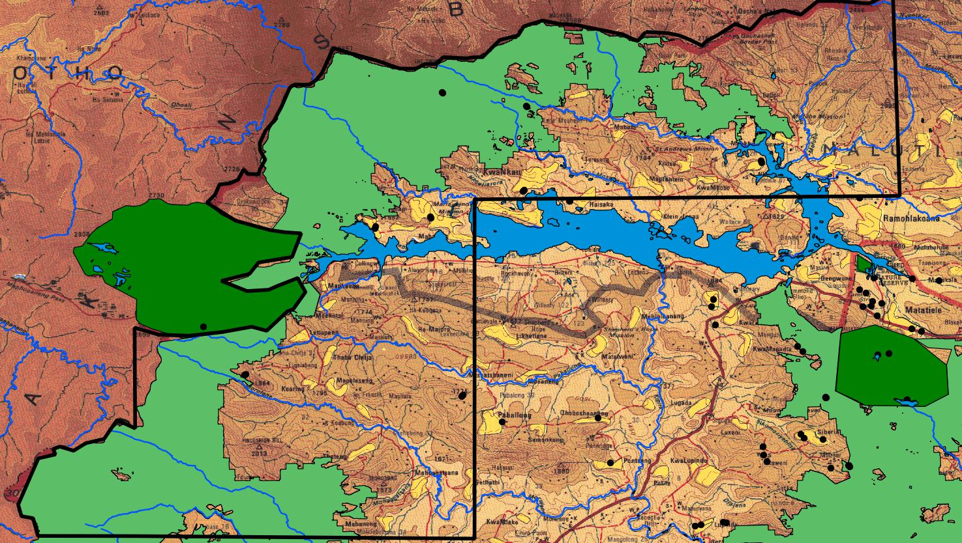

Slide 11


What is “Fracking?”
Hydraulic Fracturing:
  Drilling of wells into tightly compacted rock strata to depths of 3 to 5 kms
  Injection of water, sand and chemicals via well into strata
  Splitting of rock seams below the surface to fracture the layers
  Capturing gas for transporting to production site
  Disposal of wastewater return
11

Slide 12
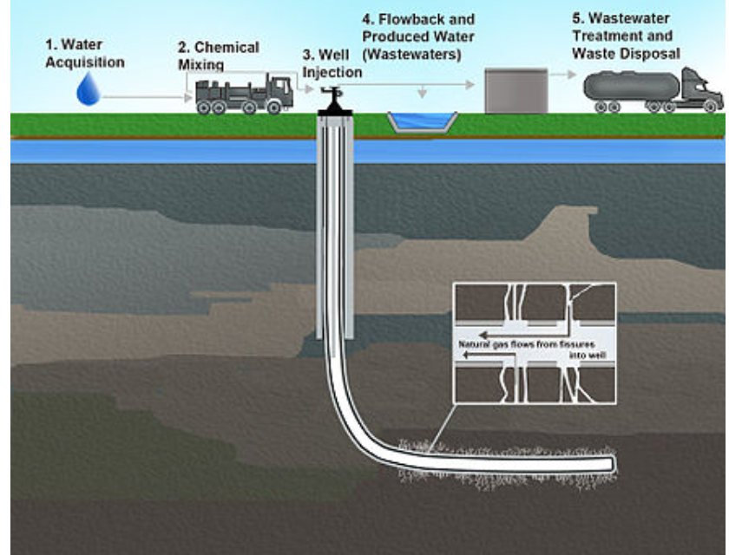
25 million litres per well
Matatiele water consumption 4 million litres / day

Slide 13
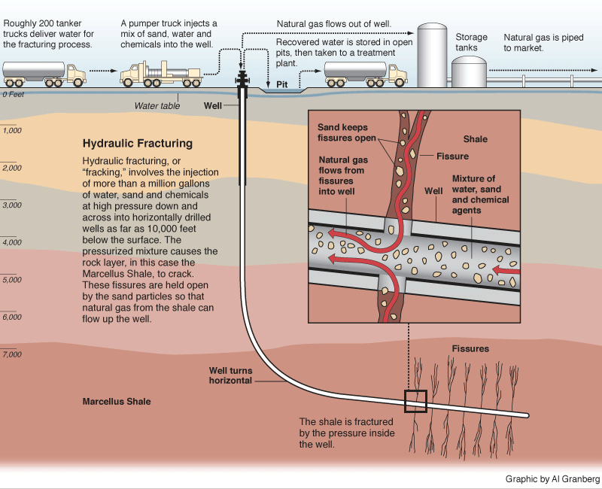

Slide 14



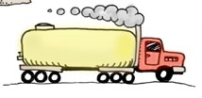
A recipe for ONE well development
UP TO…
25 million litres water
200 thousand litres chemicals
150 thousand kgs sand
2,000 diesel burning trucks

Slide 15
HEALTH RISKS:
Fracturing requires cocktail of chemicals: known carcinogens, VOCs etc
  Benzene: Linked to leukemia, other cancers, reproductive and developmental disorders.
  Toluene: long-term exposure may affect nervous system,
  cause birth defects.
  Methane, ethane and propane: high levels of exposure may cause collapse, convulsions, coma, death.
Exposure to fracking fluids linked to infertility, stillbirths, and premature death. Declining diary production

Slide 16
SOCIO-ECONOMIC CONCERNS
Farming and grazing may be compromised by water stress, increasing reliance on social grants
Ecosystem stress: less resilience to climate change, increased human stress
Water from land becomes unsafe to drink
  US: some communities forced to provide bottled water to their horses, let alone themselves
De-valuation of land
Decrease in tourism sector
Health concerns, decreased productivity
16

Slide 17
The Truth about Job Creation
An R8 million investment generates…
Natural gas 5 jobs
Coal 7
Smart grid 12
Wind 13
Solar 14
Biomass 16
Building retrofits 17
Public transport 22
Agriculture 40

Slide 18
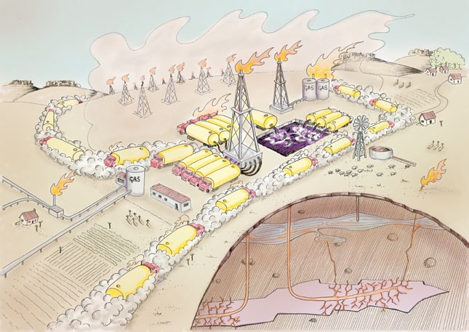

Slide 19
THE LOWDOWN ON FRACKING
BENEFITS / PROMISES
CONCERNS
Less dependence on oil and gas imports nationally
Job creation (none during exploration phase; highly skilled externally sourced during development)
Local economic boom (accommodation, supplies)
Huge water requirements in a water stressed area
Ground and surface water contamination (Matat is 100% dependent on groundwater: streams start with springs)
Methane pollution: dozen times more potent greenhouse gas than carbon
Exposure to toxic chemicals; health risks
Loss of agricultural productivity due to damaged land

Slide 20
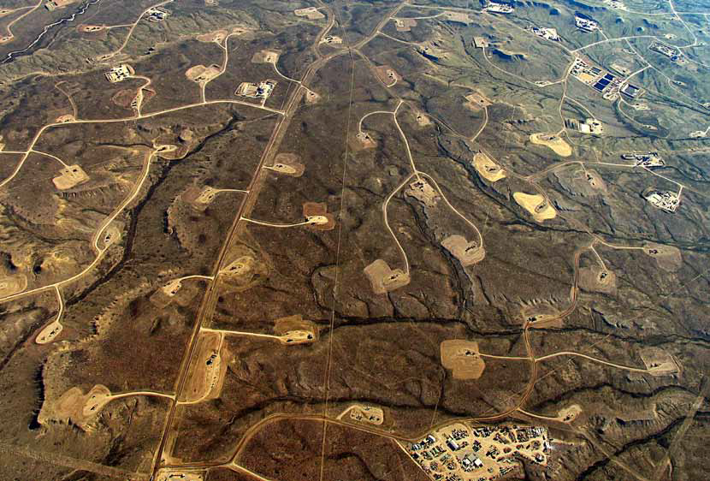

Slide 21
WHAT’S IN IT FOR MATATIELE?
The Choice is Yours
  Water security
  Livelihoods
  Health
  For all. Forever
  You can choose to agree or you choose not to agree, but you cannot choose not to choose.
  Don’t be fooled, be informed

Slide 22
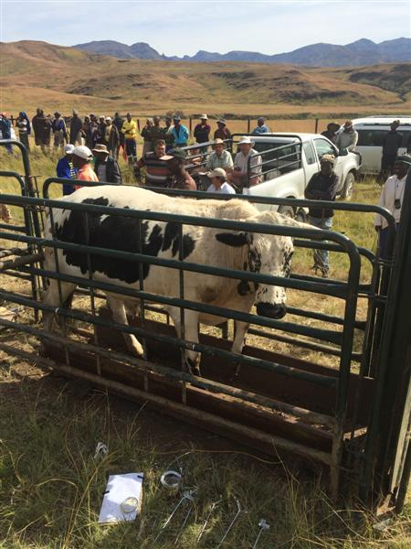
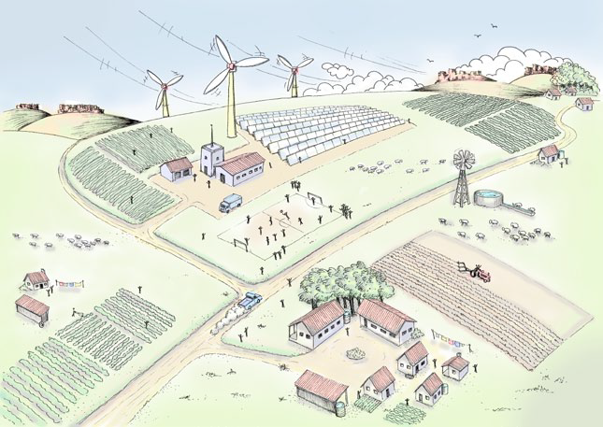
So what can YOU do?
What do WE do?
Choose renewables
Highlight local production alternatives
Exercise your constitutional right to a clean & healthy environment: Say NO!! To outside exploitation!!

Slide 23
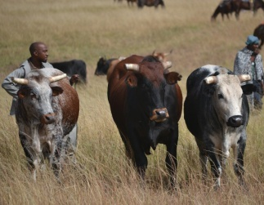
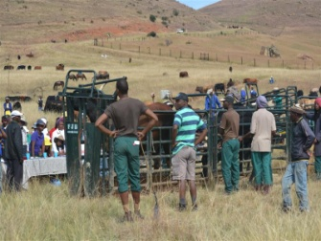
RANGELAND & LIVELIHOODS RESTORATION PROGRAMME:
“MEAT NATURALLY”
750 jobs (clearing, herding)
6000 ha improved grazing
50 000 ha fire protection
R35 000 / hh per year
R13 m annual income

Slide 24
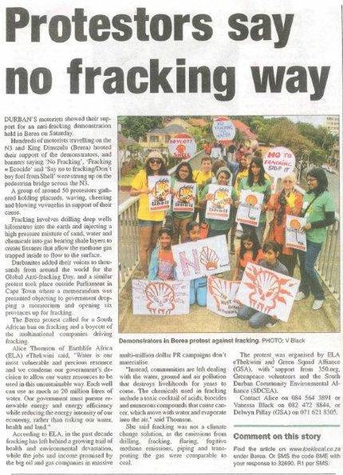
Angifun’ ifracking!
Say no! to gas exploration!
Say no! to gas extraction!
FrackFreeSA!

Slide 25
What can you do?
Sign and share Petition to Minister http://tinyurl.com/frackingecapekzn
Get informed: websites, google, facebook, “Gasland” movie, etc
www.umzimvubu.org/mining
Attend public meeting Monday 9th Nov at 12:00 at Nokwezi hall and put pressure on Rhino Oil & Gas to withdraw
Comment on the scoping report, available on www.umzimvubu.org/mining
https://umzimvubu.files.wordpress.com/2015/09/2015-10-21_slr-draft-scoping-report_-rhino-eastern-cape-295er-reduced.pdf

Slide 26
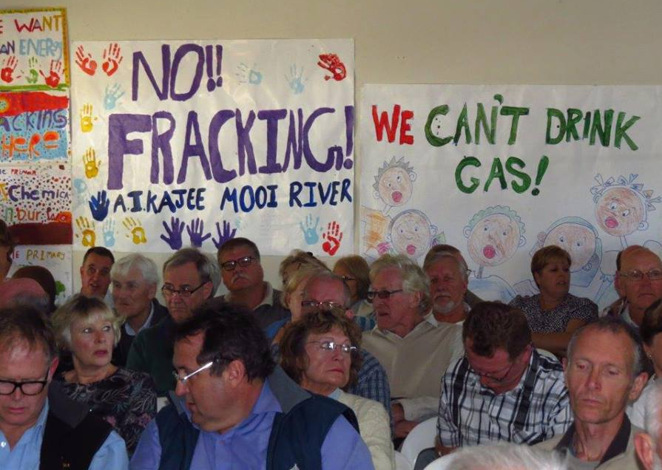

Slide 27
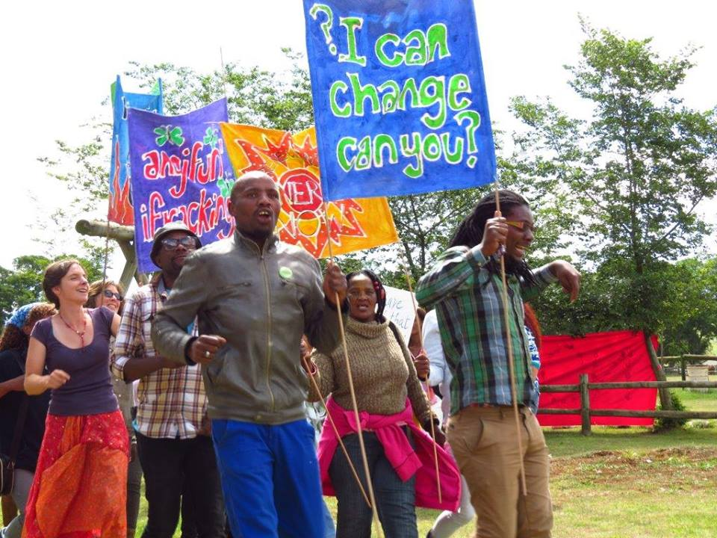

Slide 28
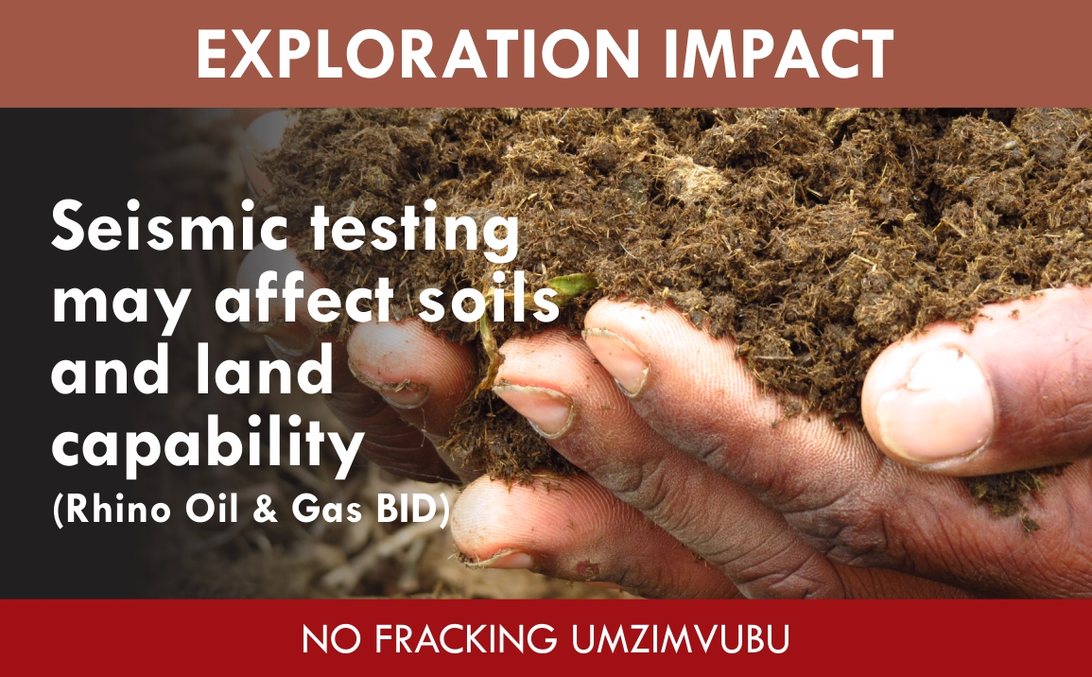

Slide 29
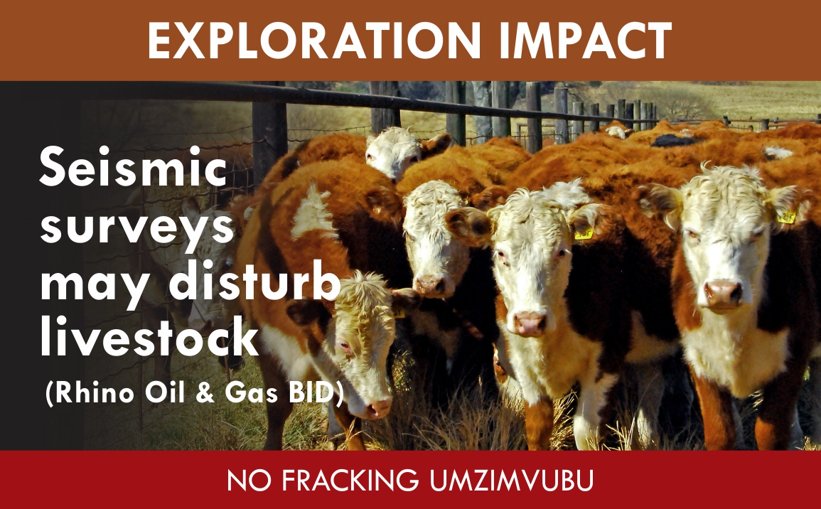

Slide 30
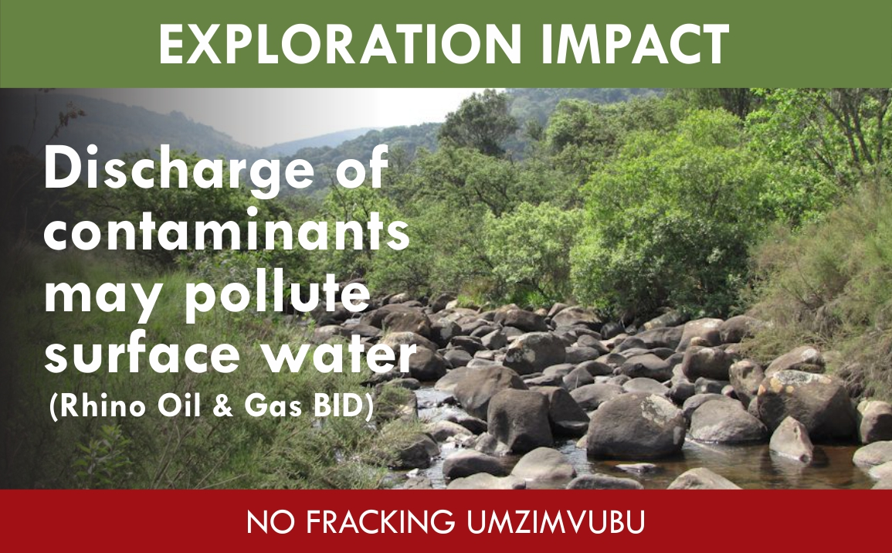

Slide 31
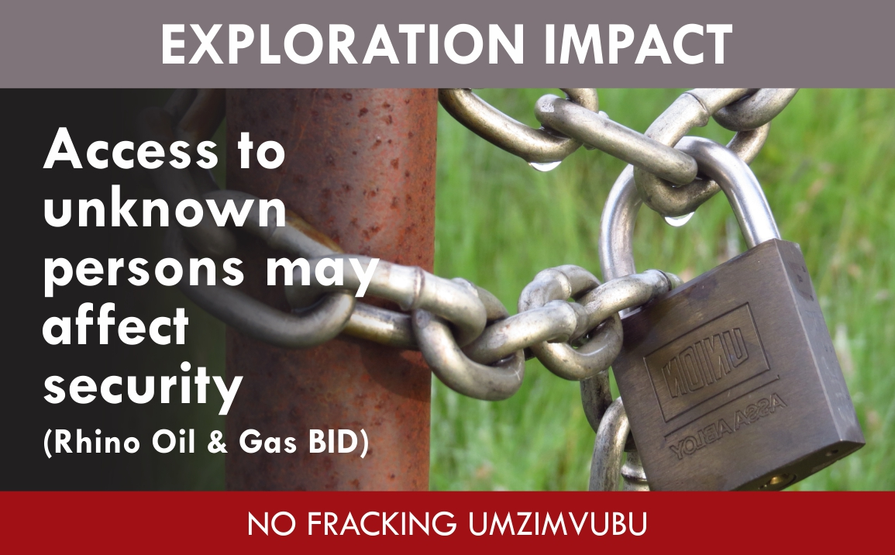

Slide 32
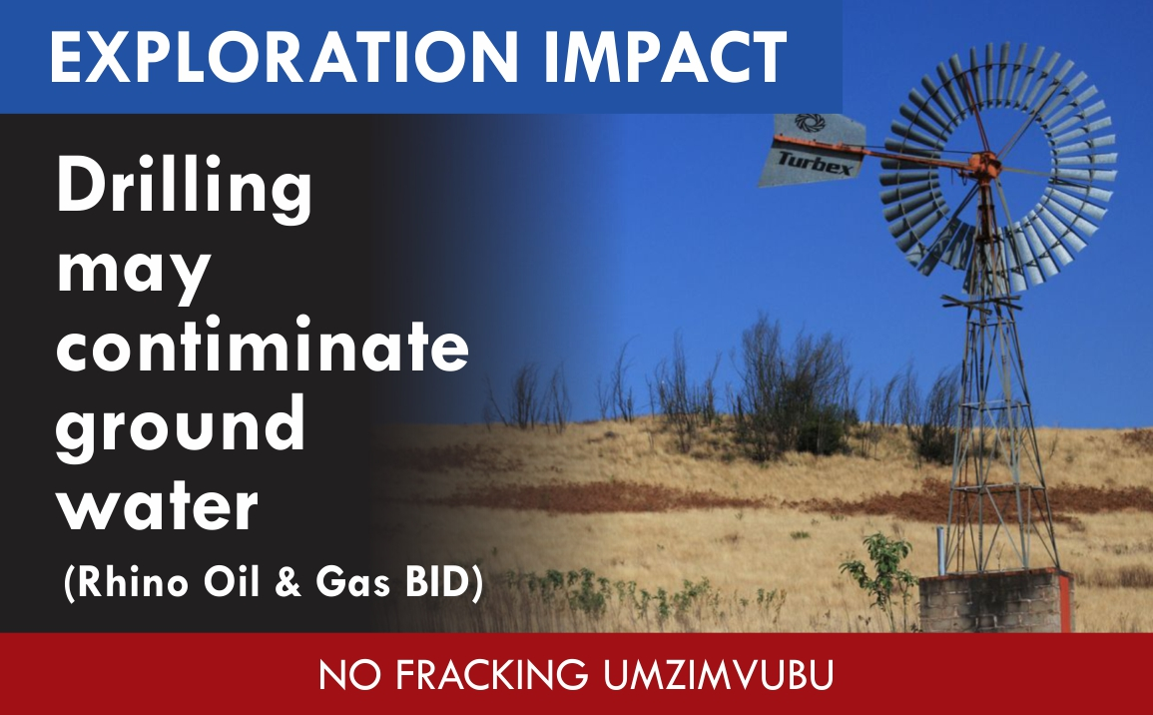

Slide 33
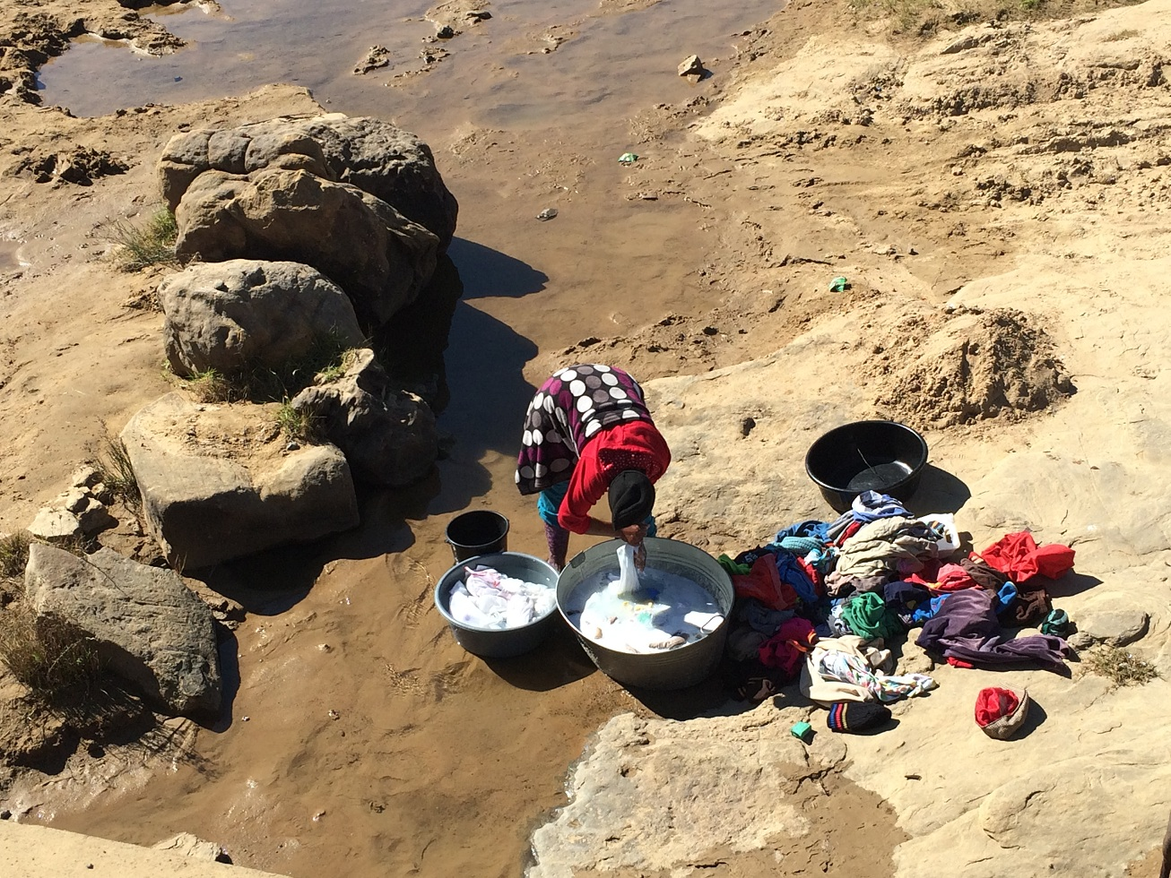

Slide 34
