Slide 1
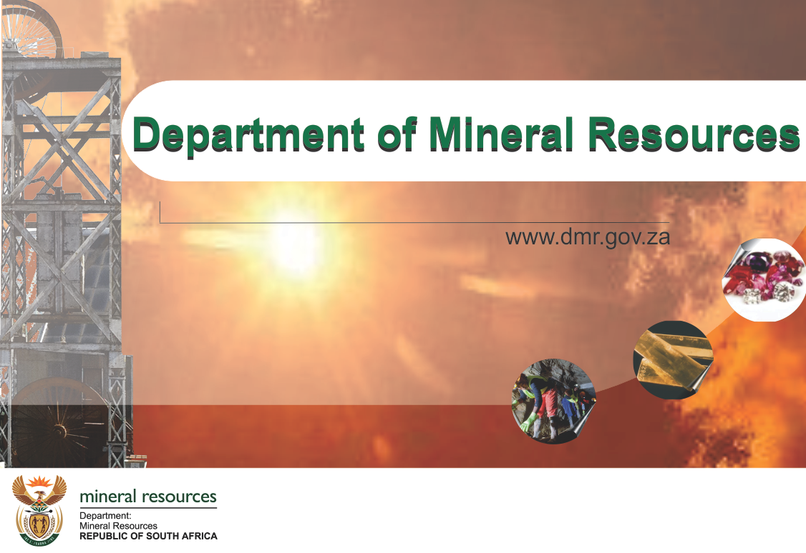

Slide 2
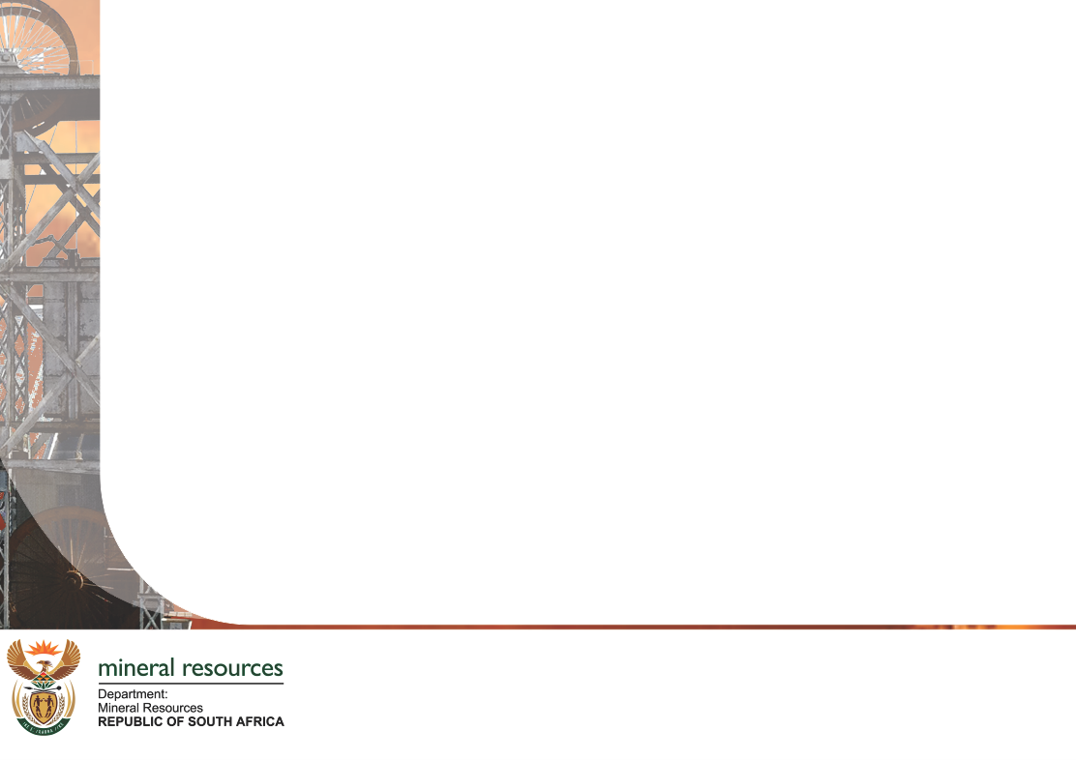
MPRDA APPLICATION PROCESS
Rupert “Ruuu” Mthembu
Mineral Laws Administration
Mthatha Satellite Office
Eastern Cape Region

Slide 3
INTRODUCTION
Eastern Cape is not blessed with an abundance of minerals such as diamonds, gold, platinum, etc.
Sand, gravel, stone, clay, etc. is plentiful
These so-called construction materials are minerals and cannot be mined without a right in terms of the Mineral and Petroleum Resources Development Act, 2002, (Act 28 of 2002) (MPRDA)
Prospecting and mining application process is governed and regulated by the MPRDA
The function and mandate of the Department of Mineral Resources (DMR) is to administer the MPRDA

Slide 4
In terms of the Mineral and Petroleum Resources Development Act, 2002 (Act 28 of 2002) ("MPRDA"), materials such as stone, gravel sand, clay, etc. are classified as minerals and the quarrying and disposing thereof is seen as mining
Section 5(4) of the MPRDA provides that no person may prospect for, or remove or mine any mineral, or commence with any work incidental thereto on any area without—
(a) an approved environmental management programme or approved environmental management plan, as the case may be; and
(b) a prospecting right, permission to remove, mining right or mining permit, as the case may be.

Slide 5
Illegal mining
Any mining activity in respect of which a right authorizing such activity, has not been granted by the Department, is illegal.
Illegal mining is an offence in terms of section 98 of the MPRDA.
Enormous damage to the environment is being caused by illegal mining as such activities are in most cases, left un-rehabilitated. Such scars in the environment are unsightly, but more importantly, often dangerous to humans and animals. It is also impossible to utilize un-rehabilitated land for agriculture or other land uses. This is definitely not the legacy we want to leave our children.
By ensuring that mining activities are legal, environmental-, social- and mine health and safety impacts, etc. can be controlled and remedied if required.

Slide 6
In communal areas the perception exists traditionally, that Community Leaders such as Kings, Chiefs and Headmen are also the holders of the mineral rights and that permission may be obtained from them to take sand or gravel, etc.
The right to remove quantities of such minerals are often granted by Authorities upon payment of a nominal fee that is often used for upgrading of facilities in the community. However, such funds are used for upgrades and no provision is made for the rehabilitation of the mined-out land.
However, it must be noted that in terms of section 3 of the MPRDA, mineral resources are the common heritage of all the people of South Africa and the State, acting through the Minister of Mineral Resources is the custodian thereof for the benefit of all South Africans.

Slide 7
As indicated previously, it is the mandate and function of the Department to administer the MPRDA.
It is therefore only through the Department that a right to mine and dispose of any mineral can legally be obtained. The issuing of rights or permissions to mine or excavate any mineral does not fall under the jurisdiction of any other person, authority or department.

Slide 8
APPLICATION FOR MINING OR PROSPECTING RIGHTS AND MINING PERMITS
Various sections of MPRDA deals with different rights
- 16 – Prospecting Rights
- 22 – Mining Rights
- 27 – Mining Permits
Must be lodged –
- on-line on the SAMRAD application Portal on the website of the Department
    in the prescribed manner
    in the correct region
    accompanied by the prescribed fee (Internet payment – Credit card).
Applicable Regulations prescribe the manner as well as the attachments that are required

Slide 9
Attachments that must be uploaded as appendixes
Sketch Plan – Regulation 2(2):
- Clearly identify area, signed by applicant and surveyor, containing:
  Co-ordinates and Spheroid (request WGS 84 in LO Format)
  North Point
  Scale
  Location map
  Farm name and number
  Extent in hectares
  Boundaries of the land
  Surface structures, servitudes
  Topography, including contours
NB - Diagram by Land Surveyor must accompany Mining
Right for registration at Mineral and Petroleum Titles Registration Office.

Slide 10
Prospecting Work Programme and Mining Work Programme
  Programmes must contain information that will indicate the applicant’s
- ability to finance proposed operation
- technical ability to execute proposed operation
- cash flow forecast including funding for social and labour plan, etc.

Slide 11
Social and Labour Plan
The objectives of the social and Labour Plan is to
promote employment and advance social and economic welfare of all South Africans
contribute to transformation of mining industry
ensure that holders of mining rights contribute towards socio-economic development of areas which they affect by their operations
ensure that holders of mining rights contribute towards socio-economic development of labour sending areas

Slide 12
Proof of Financial Competence
A budget and documentary proof of financial ability or access thereto:
- Loan agreements
- Resolution by a company to provide finances
- Any other mechanism or scheme providing finances.
- Note: bank statements cannot be considered as proof of financial
ability

Slide 13
Proof of Technical Competence
Documentary proof of technical ability or access thereto to:
- Conduct the proposed prospecting or mining operation in accordance with the applicable work programme
- Mitigate, manage and rehabilitate relevant environmental impacts
- Comply with relevant provisions of the Mine Health and Safety Act, 1996 (Act No. 29 of 1996)
- These attachments are not all that is required for an application to be accepted. Complete list of requirements on SAMRAD Application System

Slide 14
Environmental Management Programme and Plan
After acceptance of application, applicants are notified to conduct Scoping Exercise and Environmental Impact Assessment, where applicable and submit a Scoping Report and Environmental Management Programme or Plan, as the case may be.
Consultation
After acceptance of application, applicants are instructed to consult with land owners and interested and affected parties and submit the result of such consultation.
Notification
In terms of section 10 of the MPRDA the Regional Manager must make known that an application has been accepted and invite comment thereon by way of a notice.

Slide 15
The purpose of this presentation is to sensitise all persons that we all have a responsibility towards sustainable utilization of the country’s natural resources through responsible, ethical and legal practises.
THANK YOU ALL

Slide 16
Contact Details :Rupert “Ruuu” Mthembu – 082 7988 943
Email Address :rupert.mthembu@dmr.gov.za
Fax 2 Email :0866 9076 33
Port Elizabeth
Phone :041 3963900
Fax :041 396 3945
Mthatha Office
Phone :047 5324488 or 047 532465
Fax :047 532 4547

