Slide 1


African Foreign Study Programme
Exploring ways to support locally-relevant research

Slide 2
4-year, liberal arts
Educate “the most promising students and prepares them for a lifetime of learning and of responsible leadership”
>45 faculty led off campus programmes in <20 countries

Slide 3
African Foreign Study Programme
Natural resources and environment
Wildlife and conservation
Development and conservation
Social and political aspects of development and conservation

Slide 4
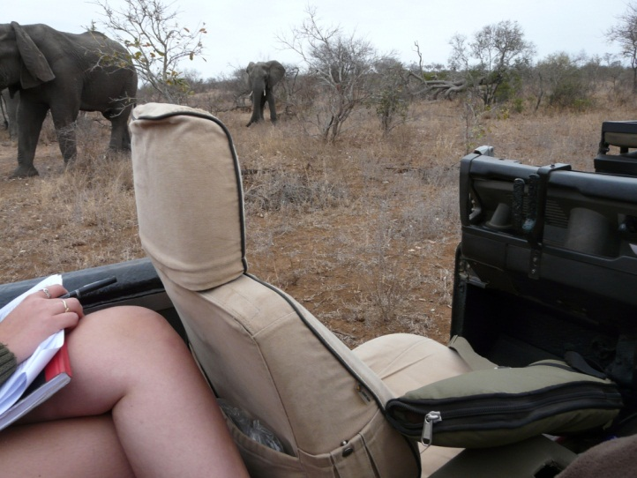
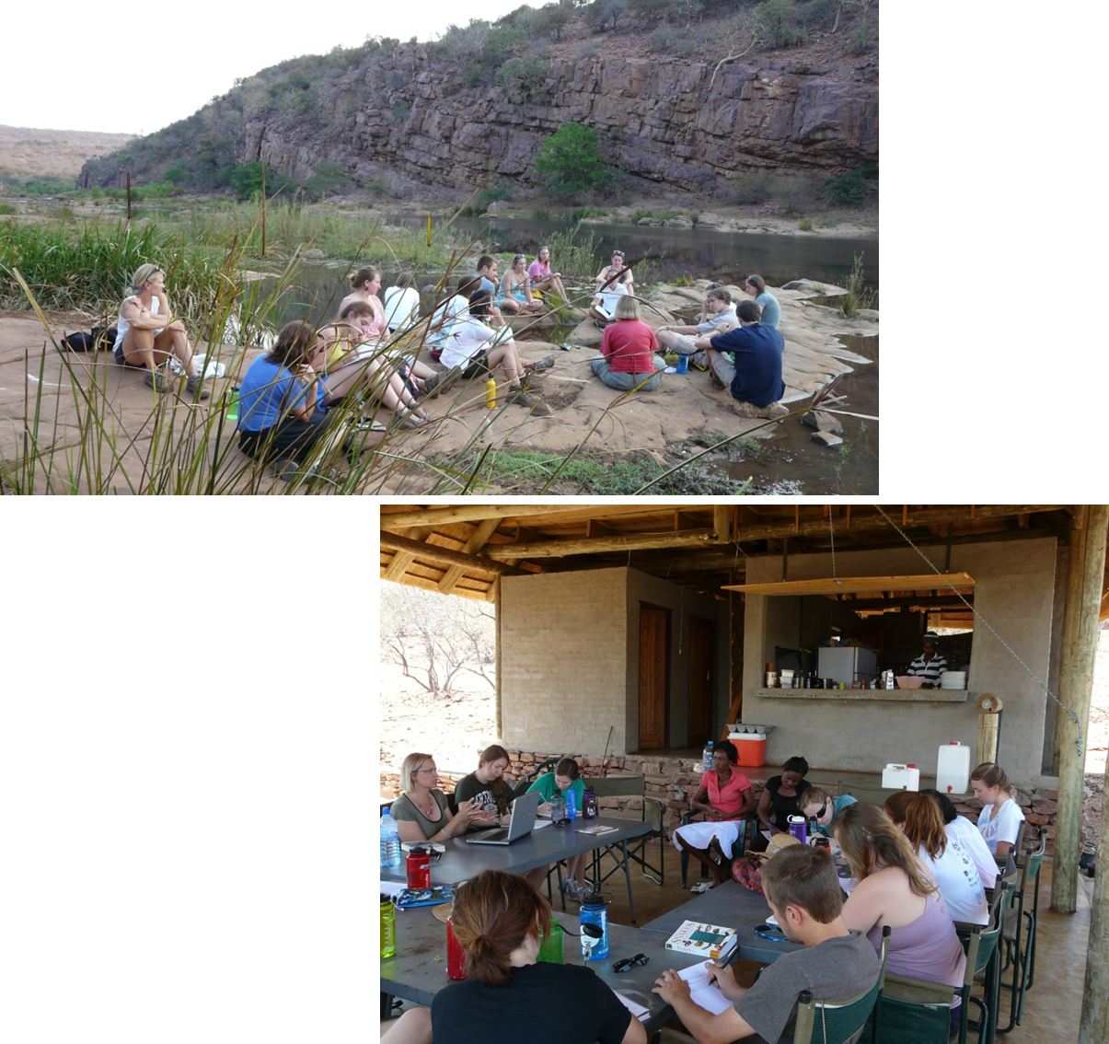
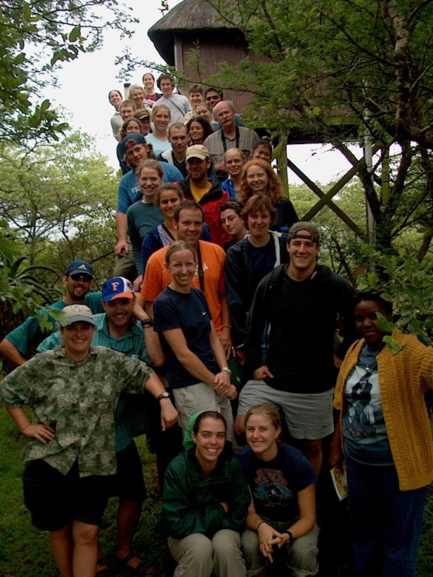
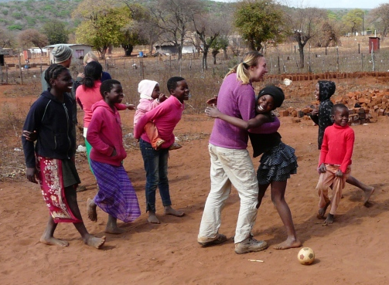
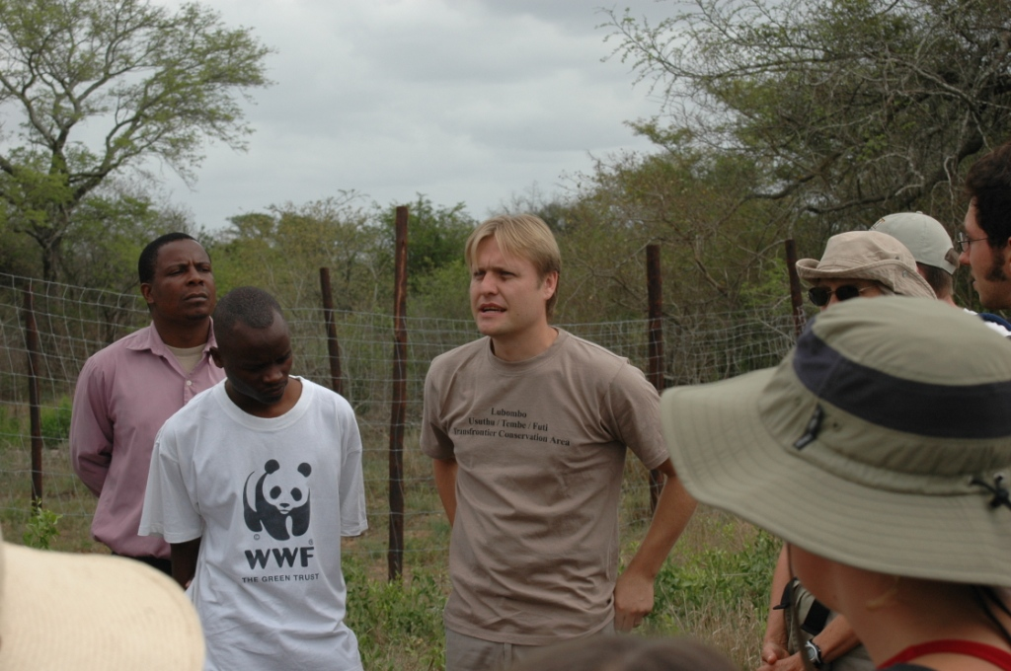
African Foreign Study Programme

Slide 5
Supporting locally-relevant research projects
Dung beetle monitoring in Tembe Elephant Reserve
Natural resource utilisation in haMakuya, Limpopo
Human health impacts of smoke inhalation in haMakuya, Limpopo
Elephant behavior observations in Timbavati
Desert ecology research projects at Gobabeb

Slide 6
New era – Matatiele & surrounds
Matatiele, 20-27 September 2016
Learn
Opportunities to support research:
  Linking research support with active research projects that address 'real' practitioner challenges and questions
  Role of students in supporting locally-relevant research
  Our role in supporting other objectives???

Slide 7
Dartmouth AFSP Research
AFSP students
16 capacitated outsiders
Equipped
AFSP Faculty
Prof Michael Cox
Prof Coleen Fox
Dartmouth
Other faculty
Other students
Notes:
Global Exploratoty/Development Grant: The goal is to facilitate Dartmouth's research mission, promote its academic reputation outside the United States, enhance the recruitment of international faculty and students, and build sustainable partnerships with institutions around the world.
Fulbright Program awards approximately 8,000 grants annually. Roughly 1,600 U.S. students, 4,000 foreign students, 1,200 U.S. scholars, and 900 visiting scholars receive awards, in addition to several hundred teachers and professionals.

Slide 8
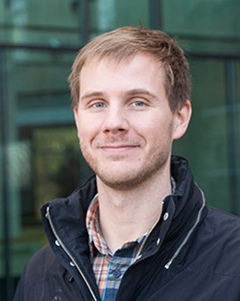
Dartmouth Faculty: Michael Cox
Environmental social scientist
Studies community-based natural resource management, environmental governance, and the determinants of resilience and vulnerability in social-ecological systems.
Research includes:
  Empirical fieldwork-based analyses of irrigation systems in the Southwest US, Peru and Kenya.
  Small-scale fisheries management in the Dominican Republic.
  Synthetic analysis of large-scale environmental governance.

Slide 9
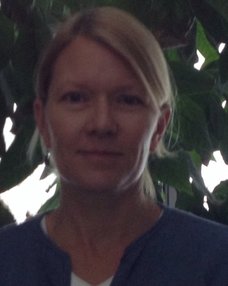
Dartmouth Faculty: Coleen Fox
Political and environmental geographer
Studies water, geopolitics and economic development in international river basins.
Research includes:
  Role of indigenous peoples in river stewardship & sustainable futures.
  social dimensions of dam removal.
  Riverine re-connectivity and watershed resilience.

Slide 10
Dartmouth AFSP Research
AFSP students
16 capacitated outsiders
Equipped
AFSP Faculty
Prof Michael Cox
Prof Coleen Fox
Dartmouth
Other faculty
Other students
Int Research Travel Grant
Global Exploratory/ Development Grant
Fullbright Program
Notes:
Global Exploratoty/Development Grant: The goal is to facilitate Dartmouth's research mission, promote its academic reputation outside the United States, enhance the recruitment of international faculty and students, and build sustainable partnerships with institutions around the world.
Fulbright Program awards approximately 8,000 grants annually. Roughly 1,600 U.S. students, 4,000 foreign students, 1,200 U.S. scholars, and 900 visiting scholars receive awards, in addition to several hundred teachers and professionals.

