Slide 1
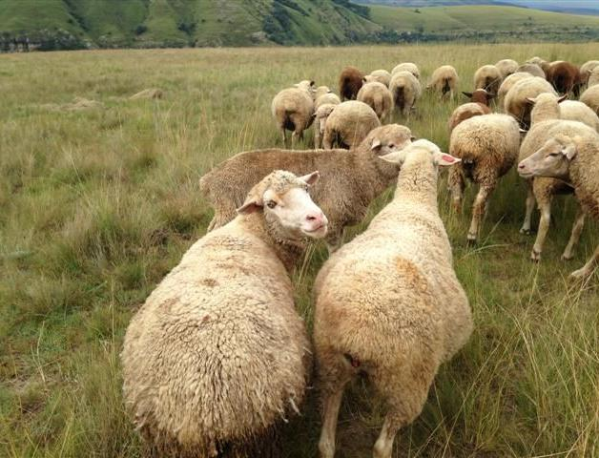




Meat Naturally Initiative

Slide 2
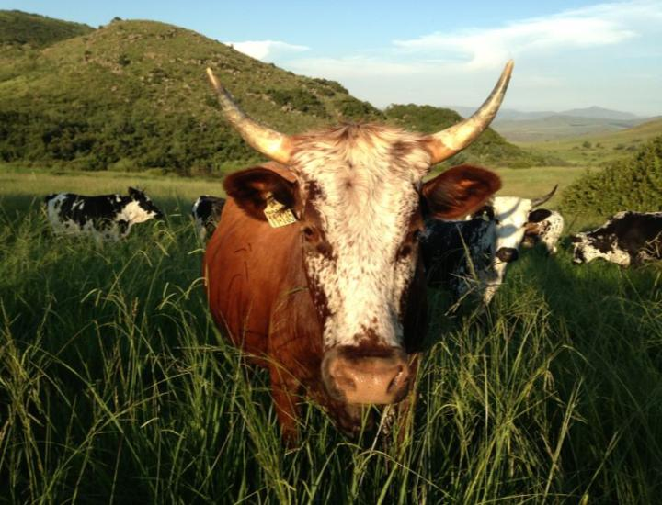
Ecorangers: Jobs, Skills, and Natural Meat for South Africa

Slide 3
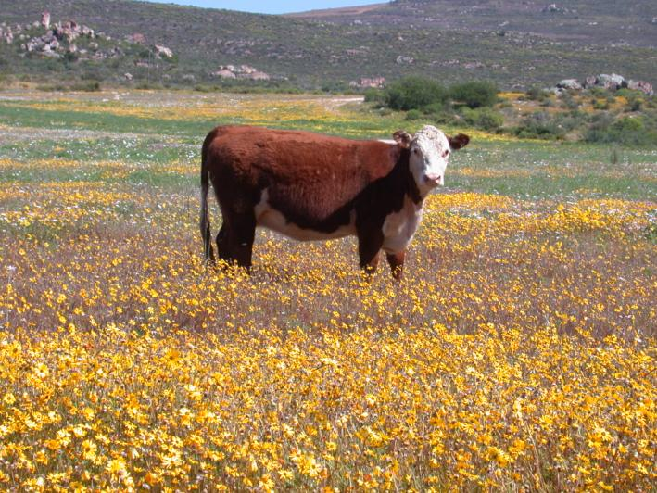
Conservation as a land-use…

Slide 4
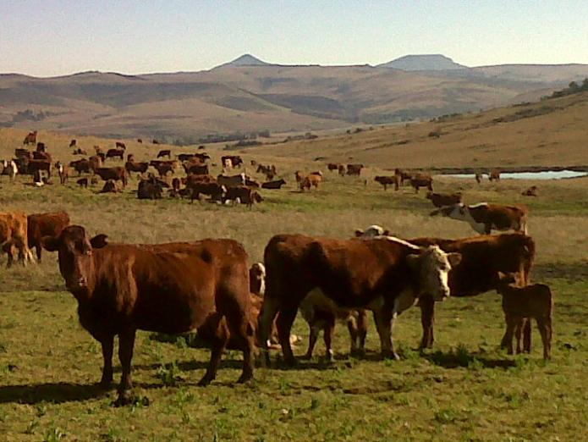
GOAL: By 2017, red meat production in SA supports biodiversity conservation and healthy ecosystems
for long-term benefits of people and nature.

Slide 5
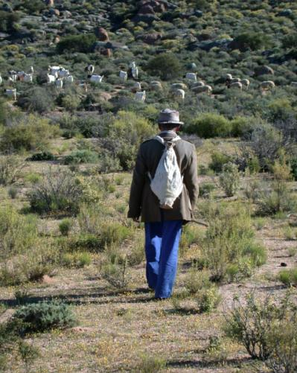
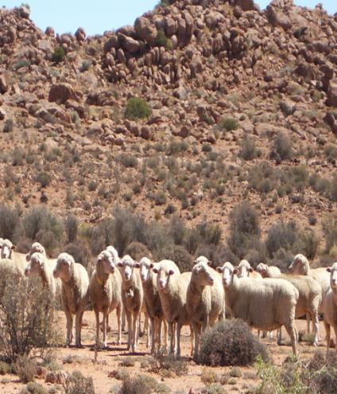
47% of livestock is
on communal lands
53% of livestock is on private lands
5% of market
95% of market

Slide 6
Key barriers to market entry for communal farmers…
Distance to market;
Health of animals (presence of parasites in cattle);
Condition of animals is often too poor to be attractive to meat purchasers;
Little traceability and even proof of ownership lacking;
Current meat classification system not in favour of older naturally raised animals;
Poor rangeland condition from historic overgrazing and “tragedy of the commons” management prevents herd improvement for commercial sale.

Slide 7
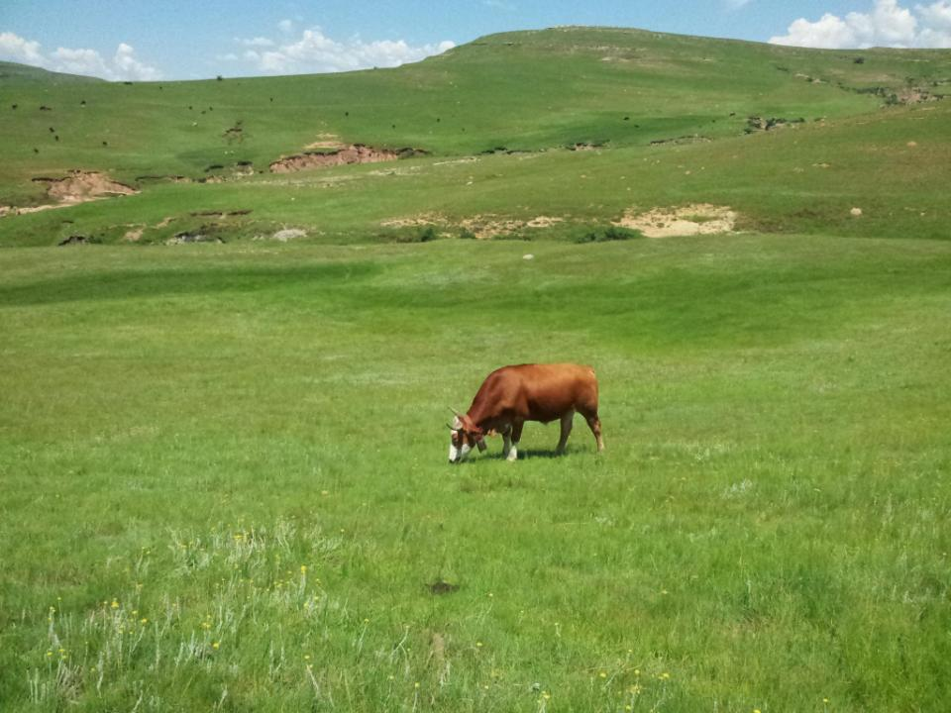

Rangeland Restoration:
Ward 14, Matatiele, Eastern Cape
Introducing EcoRangers and collective herding
PILOT PROJECT

Slide 8
Herding and grazing management
The aim is to both improve and restore veld and grazing as well as animal condition. Basic reasoning for the approach is as follows:
Grass growth and need for rest
Notes:
Today we focus on veld and grass and reaction to grazing

Slide 9
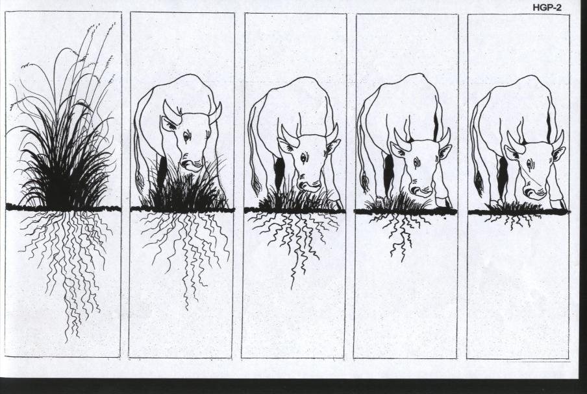
Continual grazing
Notes:
Cut grass and roots demo

Slide 10
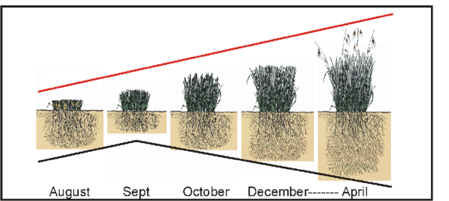
Repeated grazing during summer will deplete the plant strength and vigour due to depletion of root reserves;
Repeated grazing year after year will result in palatable species (T. triandra) dying out and replacement by non-palatable species;
Full growing season rest once every 3-5 years is essential to maintain plant vigour and to prevent veld degradation and a decrease in grazing capacity.

Slide 11
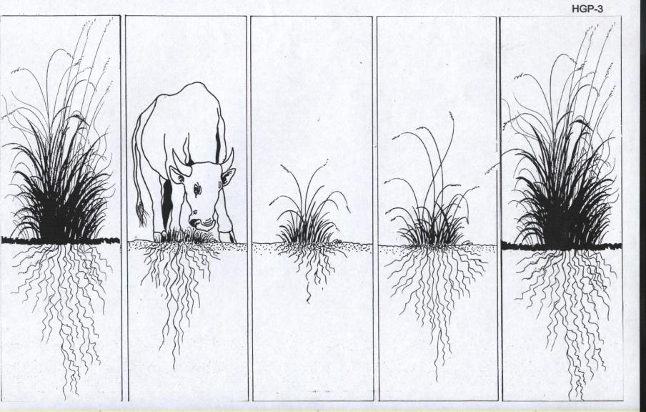
GRAZING AND REST

Slide 12
Different species of grass
Palatable (e.g. Red grass Themeda triandra)
  Tasty throughout year;
  High nutrion & high grazing value.
Non-palatable (e.g. Eragrostis plana)
  Mostly hard/tough,
  little nutrition,
  seasonal use only,
  not tasty.

Slide 13
Grazing management for improved grassland
Area around village is destocked during summer to rest, recover and improve and to allow cropping to take place.
Animals return in winter and grazing around village is used as spared veld for winter grazing together with cropping residues.
Protecting the veld from fire around the village is essential during winter;

Slide 14








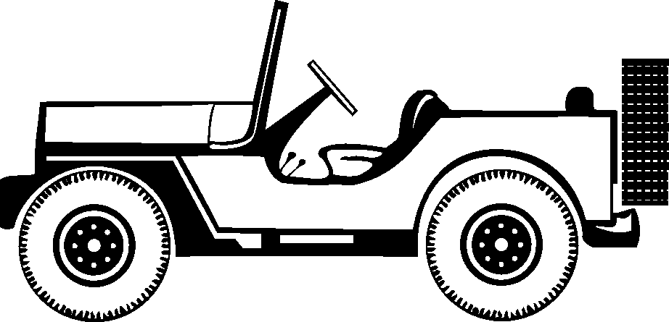


GA2
GA1
Q4
Q1
Q4
Q1
Q3
Q2
Q3
Q2
GA3
Q4
Q1
GA4
2.5 – 5kms
Q4
Q1
Q3
Q2
Q3
Q2

Slide 15
Mobile Kraaling and grazing blocks
Mobile overnight kraal located away from village during the summer months around which herd is controlled to graze in blocks/quadrants (Q1,Q2 etc) .
Depending on grazing conditions, the basic approach is to graze each quadrant for a week at a time, after which the kraal is moved to a new grazing area (GA).
Ideally both grazing areas and grazing quadrants should utilise natural boundaries as far as possible to ease implementation.

Slide 16
GRAZING AREAS
Ideally up to 4 GA should be allocated for each herd = maximum resting and re-growth of grass in between quadrant grazing and also to rest each GA rotationally for a whole season every 3rd summer.

Slide 17
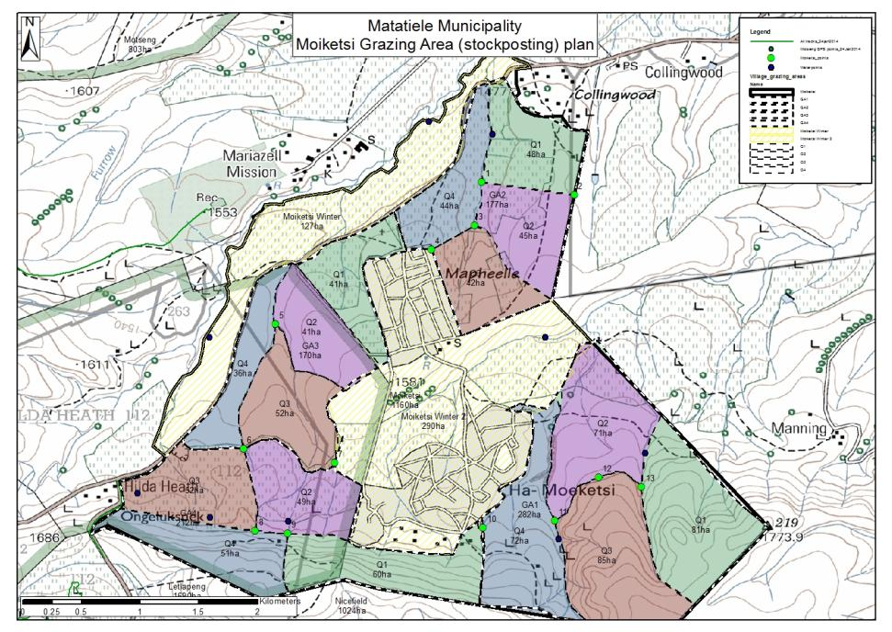

Slide 18
WHAT APPROACH IS USED?
Approached tribal structure firstly (chief and local headmen);
Working with villages keen to improve, but willing to commit and test;
ERS long term HLM work at Motseng;
Integrated with alien plant eradication and restoration of ecosystem services (water catchment area);

Slide 19
HOW IS IT BEING IMPLEMENTED?
Mobile electric kraal for stockposting
Animal handling facilities (treatments, marking, sales etc)
Livestock tagging and record-keeping on central database
Vaccinations as incentives and reward
Linking to market
ECORANGERS (herders) from village through NRM funds (Dept. Env Affairs) with existing herders
Signed agreements with livestock owners for set period to commit both parties
Veld condition assessments to compare stocking rates and carrying capacity and to measure change in condition over time

Slide 20
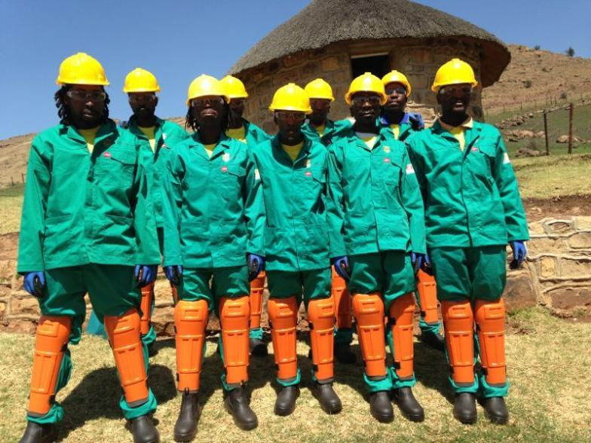
Upper Umzimvubu Catchment Clearing: 50 people clearing only and 28 ecorangers

Slide 21
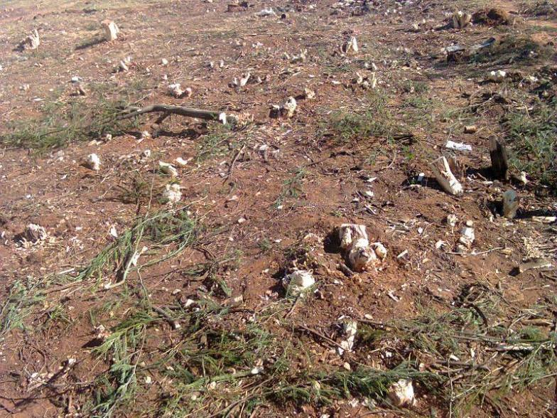
Once areas are cleared, need to restore grass quickly to prevent regrowth and erosion…

Slide 22
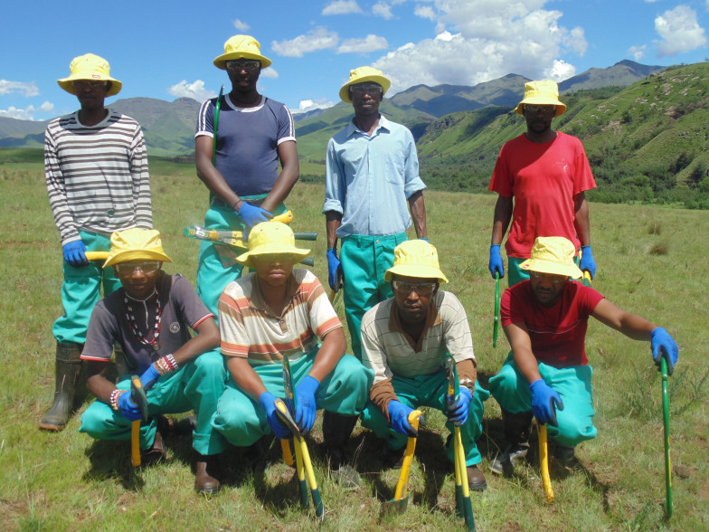
How do ecorangers do this??

Slide 23
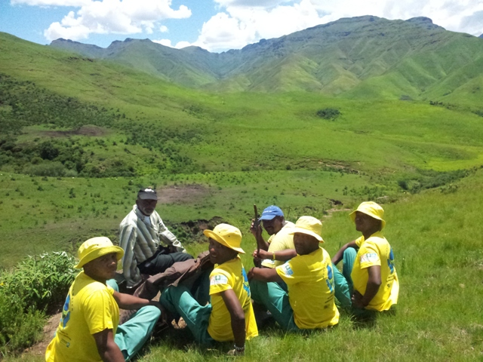
Grazing planning with elders and CSA

Slide 24
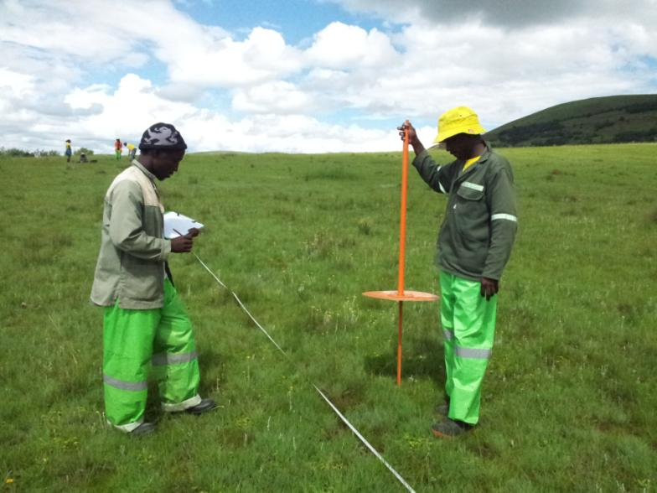
Training and veld assessment and monitoring

Slide 25
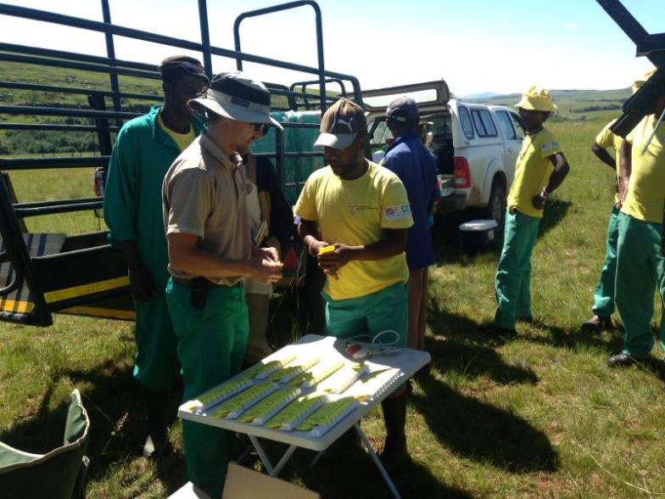
Ecorangers assist in ear-tagging livestock going into communal herd, providing ownership tracking and traceability for market and prevention against stock theft

Slide 26
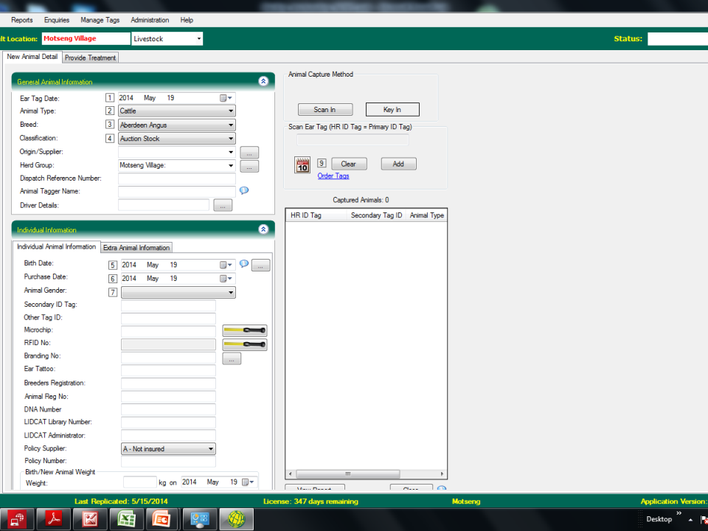

Slide 27
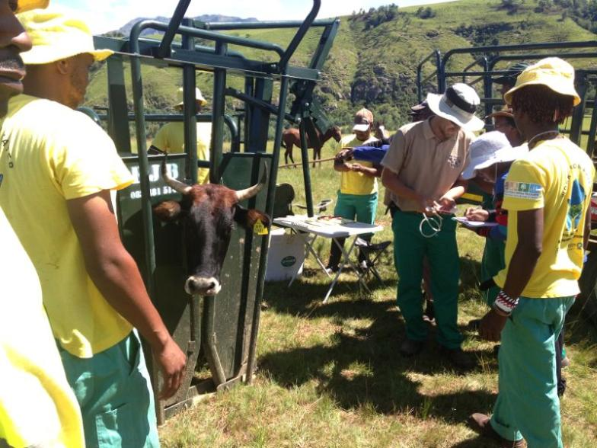
And vaccinations for improved livestock health and associated revenue potential

Slide 28
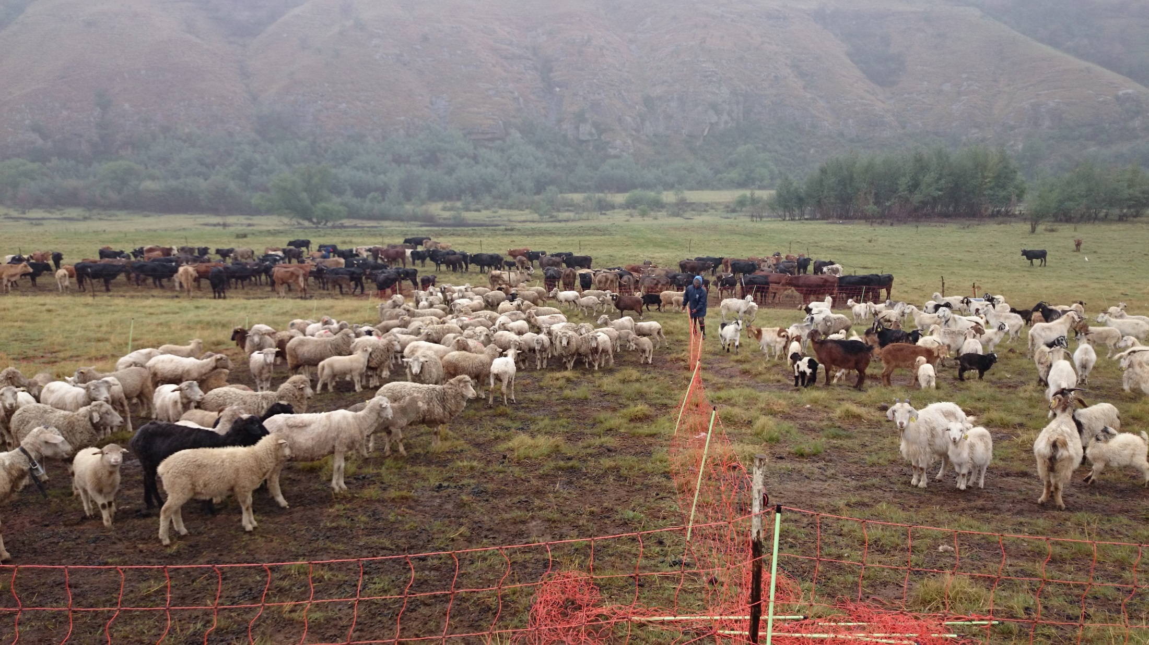
Ecorangers manage mobile kraal…

Slide 29
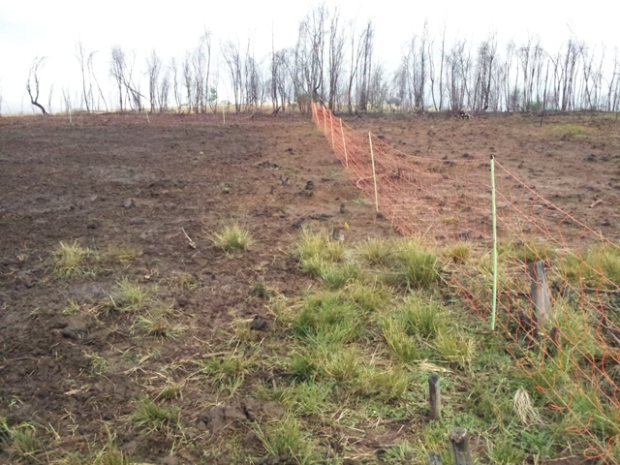
To ensure concentration of dung on areas requiring restoration…

Slide 30
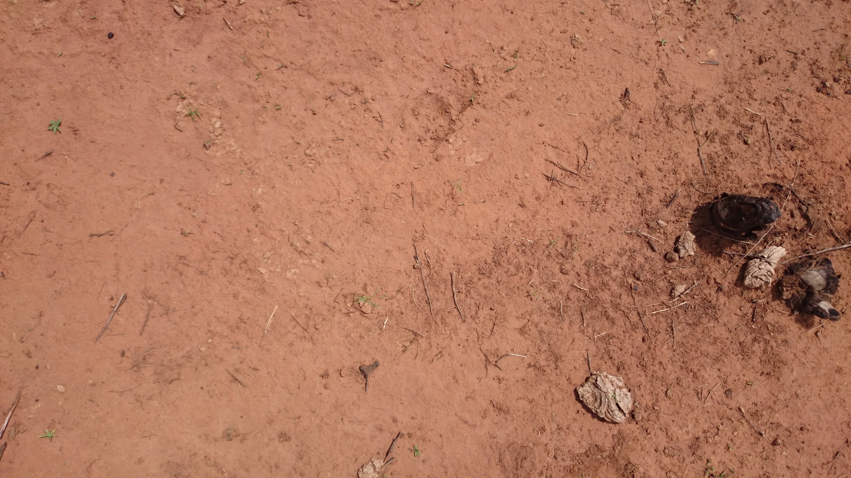

Slide 31
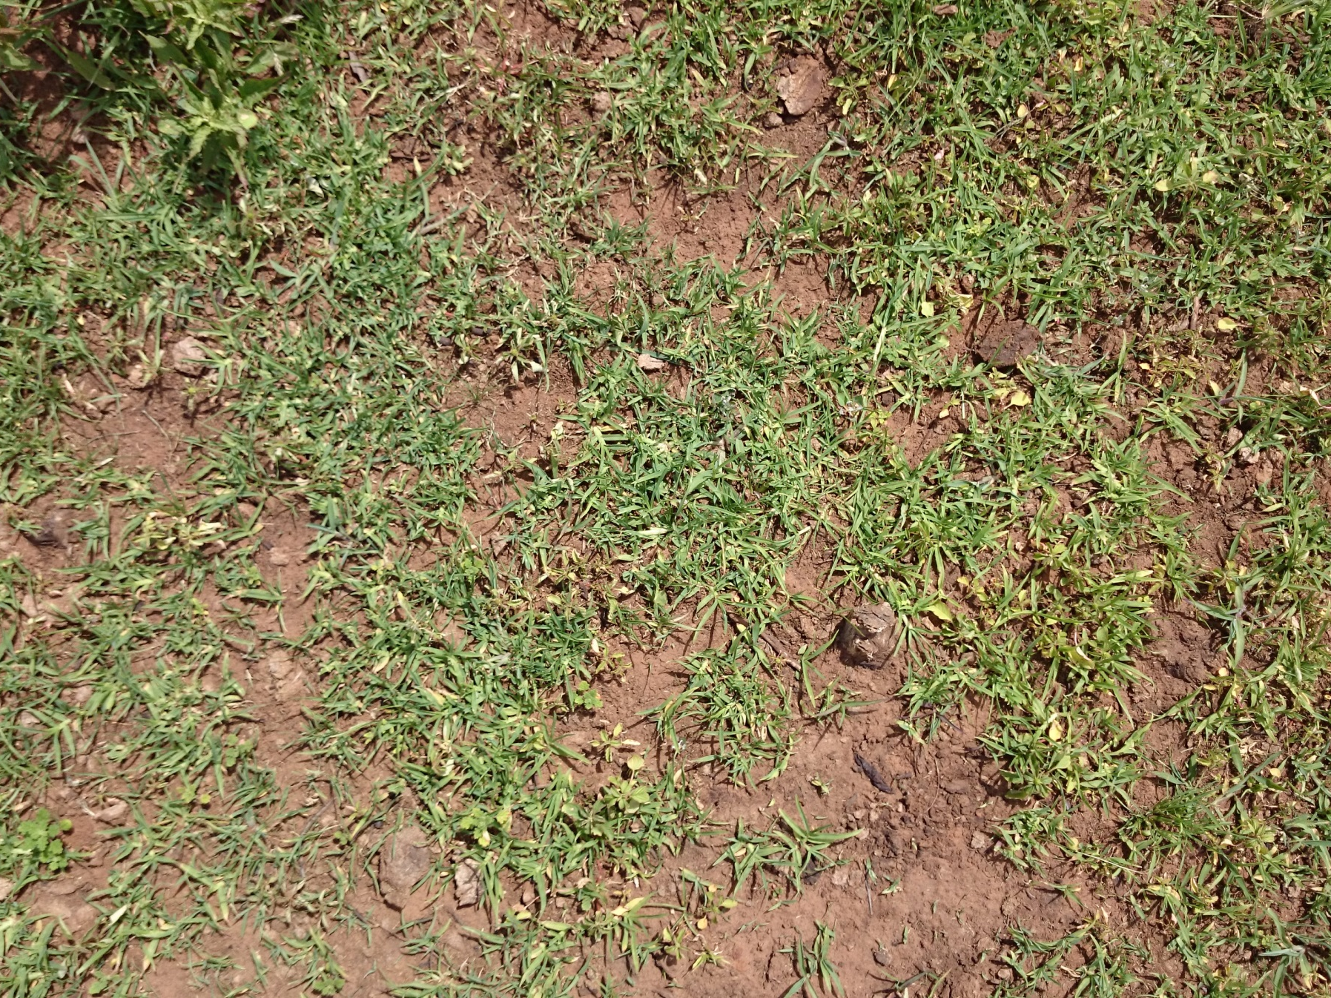
Cover with trampling

Slide 32
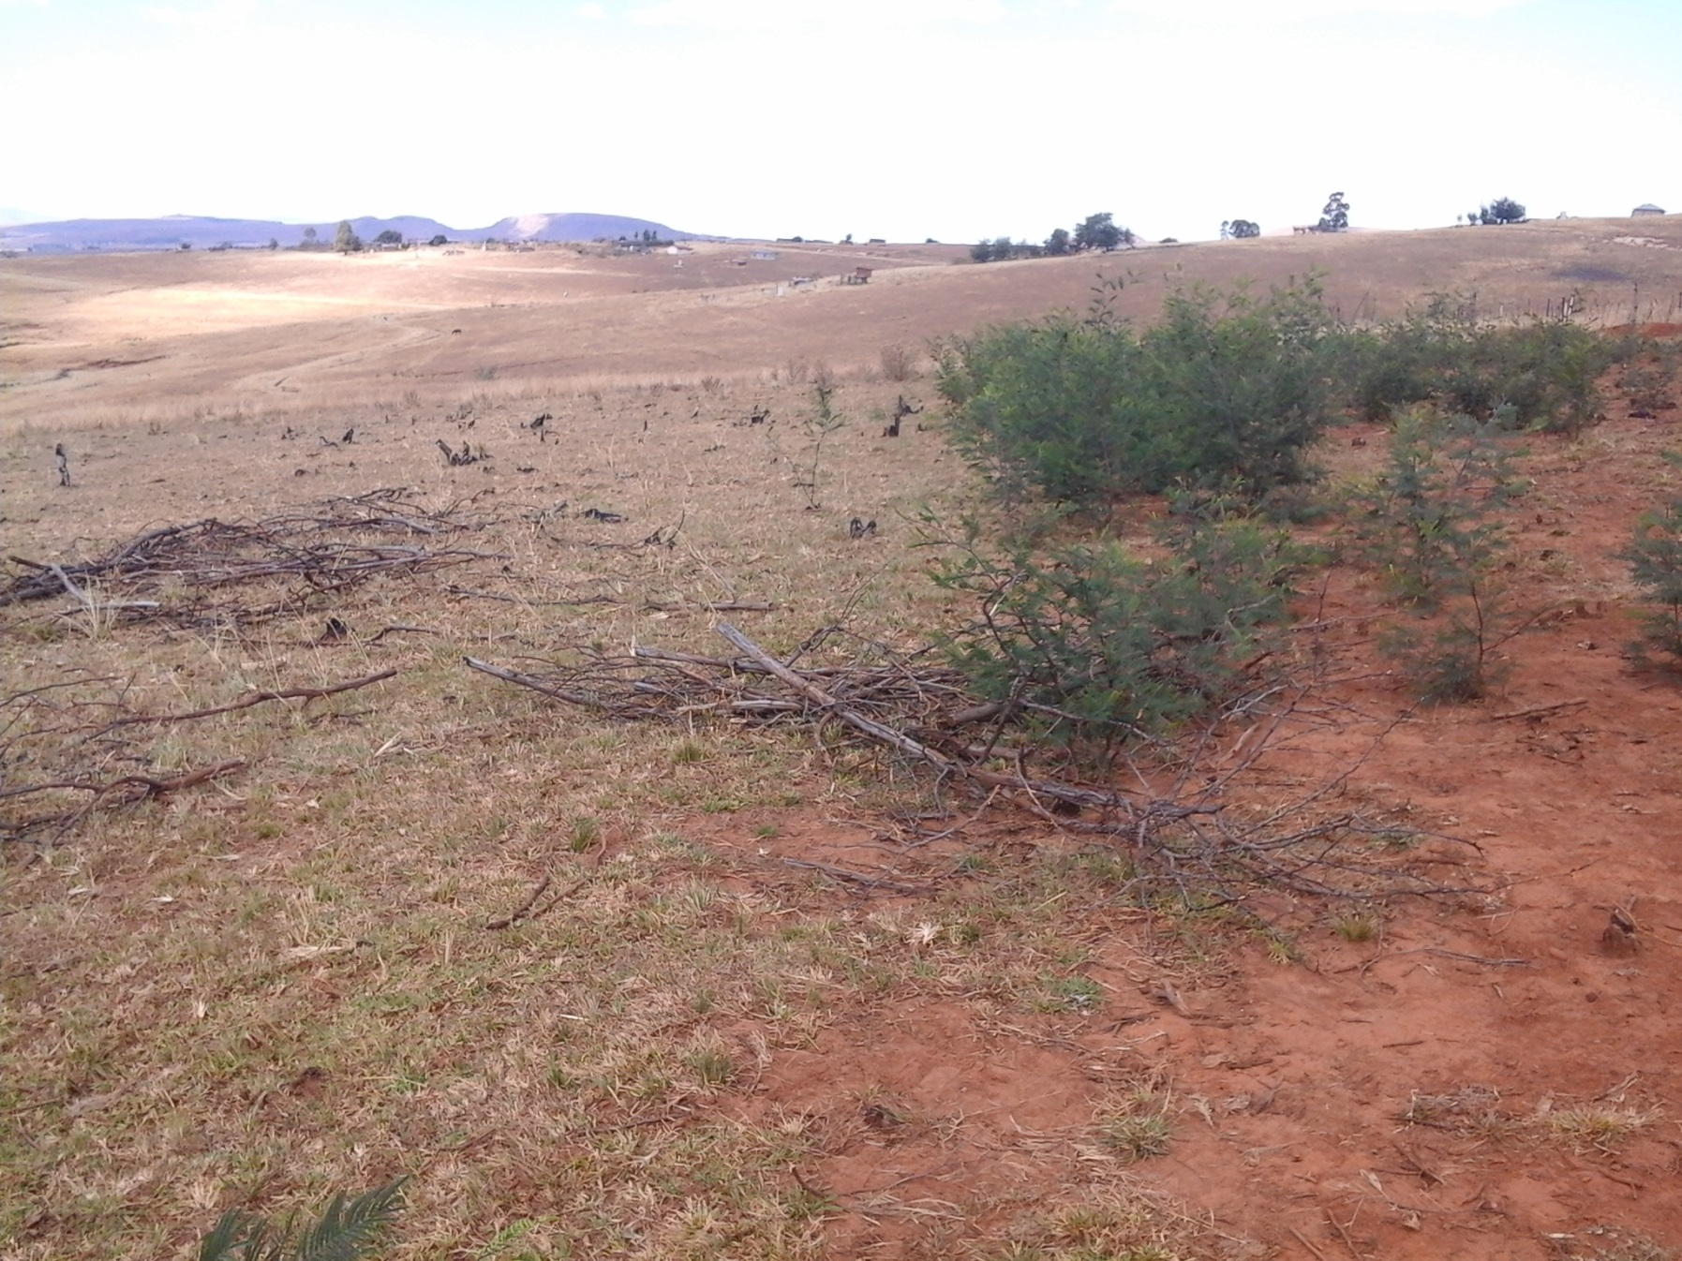
Line of wattle outside trampling site

Slide 33
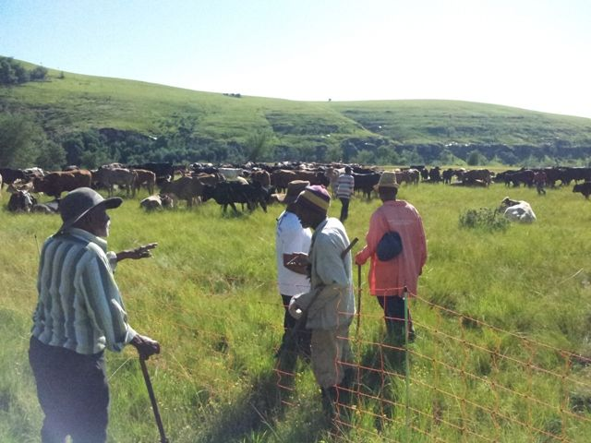

Slide 34
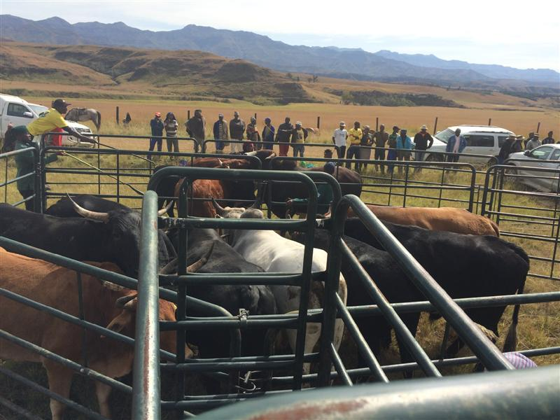

Slide 35
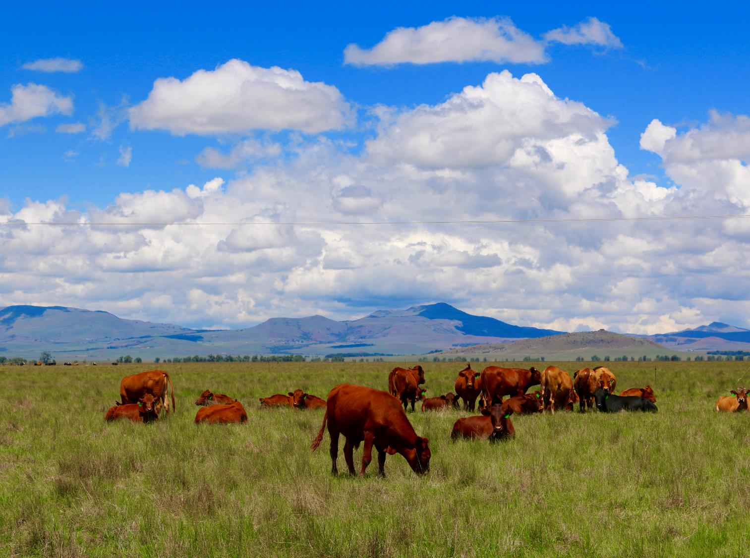
MEAT NATURALLY PTY

Slide 36
meat naturally PTY: vision
The Meat Naturally Initiative strives to be a facilitator of both the land restoration and market sales services
Production / Landscape Restoration Products & Services
Sales Support Product & Services
Grazing Planning
Equipment &
Veterinary Services
Eco-ranger Training
Ecoranger Supervision & Mgmt
Mobile Auctions
Market Contracting & Distribution
Auditing of Grassfed SA Protocols
Paid by government contracts
Paid by market and farmers
Source: CSA Application Form for Implementing Agents for Natural Resource Management Programmes and Land User Incentives

Slide 37
Ecoranger job description
Para-vet functions
Livestock husbandry
Alien plant control (follow-up/preventing spread)
Environmental awareness
Auction support
Kraaling
Livestock protection
Basic administrative functions

Slide 38
Auction results
Stock Sale | 11 May 2016
No of stock offered | 145
No of stock sold | 124
No of stock not sold | 21
% Sold | 85.52%
Highest price | ZAR 10,150.00
Lowest price | ZAR 2,000.00
Ave R/kg offered | ZAR 11.48
Ave R/kg sold | ZAR 11.43
Total turnover | ZAR 695,600.00
Total no of bulls offered | 7
Total no of bulls sold | 6
Ave R/kg bulls sold | ZAR 10.41
Total no of oxen offered | 108
Total no of oxen sold | 92
Ave R/kg oxen sold | ZAR 11.73
Total no of cows offered | 30
Total no of cows sold | 26
Ave R/kg cows sold | ZAR 10.58
No of sellers | 81
% female sellers | 20%
No of buyers | 5
No of villages | 15
Stock sale | April 2015 |  | Stock sale | June 2014
Date | 29-Apr-15 |  | Date | 23-Jun-14
No of stock offered | 182 |  | No of stock offered | 129
No of stock sold | 146 |  | No of stock sold | 76
No of stock not sold | 36 |  | No of stock not sold | 53
% Sold | 80.22% |  | % Sold | 58.91%
Highest price | ZAR 8,400 |  | Highest price | ZAR 10,050
Lowest price | ZAR 2,500 |  | Lowest price | ZAR 3,100
Ave R/kg offered | ZAR 11.30 |  | Ave R/kg offered | ZAR 11.07
Ave R/kg sold | ZAR 11.37 |  | Ave R/kg sold | ZAR 11.24
Total turnover | ZAR 871,650 |  | Total turnover | ZAR 471,800
Total no of bulls offered | 8 |  | Total no of bulls offered | 20
Total no of bulls sold | 5 |  | Total no of bulls sold | 14
Ave R/kg bulls sold | ZAR 9.70 |  | Ave R/kg bulls sold | ZAR 9.49
Total no of oxen offered | 145 |  | Total no of oxen offered | 97
Total no of oxen sold | 116 |  | Total no of oxen sold | 57
Ave R/kg oxen sold | ZAR 11.62 |  | Ave R/kg oxen sold | ZAR 11.75
Total no of cows offered | 29 |  | Total no of cows offered | 10
Total no of cows sold | 22 |  | Total no of cows sold | 5
Ave R/kg cows sold | ZAR 10.53 |  | Ave R/kg cows sold | ZAR 9.98
No of sellers | 105 |  | No of sellers | 66
No of buyers | 6 |  | No of buyers | 4
No of villages | 13 |  | No of villages | 9

Slide 39
Four business units of MNP
1
Grazing Planning
Services
Improve Quality
2
Eco-ranger Training
3
Tagging & Tracking
Access
Delivers Quality
4
Market Access – Mobile Auctions
Market Access

Slide 40
Revenue flow for service Business units
Government Agencies / Contracts / Private Donations
Government provides funding to NGOs for farming programs
Implementing Agents
Implementing Agents / Cattle Owners
Grazing Planning
Eco-ranger Training
Tagging and Tracking
Contractual Relationship
Meat Naturally Pty
Service-Based
Revenues

Slide 41
commissions through mobile auctions drive Market Access revenues
Government Agencies / Contracts / Private Donations
Implementing Agents / Cattle Owners
Buyers
Grazing Planning
Eco-ranger Training
Tagging and Tracking
Market Access
Meat Naturally Pty
Meat Naturally Pty
Service-Based
Revenues
Commission-Based Revenues

Slide 42
Expansion is projected to be slow but consistent
5-Year Operational Outlook
 | Year 1 | Year 2 | Year 3 | Year 4 | Year 5
# of Villages | 27 | 38 | 53 | 74 | 104
# of Stock | 6,750 | 9,450 | 13,230 | 18,522 | 25,931
# of Eco-rangers | 108 | 151 | 212 | 296 | 415
# of Regional Managers | 1 | 1 | 2 | 2 | 2
1
2
2
3
Village growth is purposely slow to ensure proper delivery of services
Number of stock and eco-rangers are modeled to increase linearly with the number of villages
One regional manager is added in year 3
1
2
3

Slide 43
Market access is the key to long-term growth
Market Access is the key to long term profitability…
...but all services are interrelated and necessary for overall business growth
Operating Revenues by Service
CAGR
104%
18%
27%
6%

Slide 44
With conservative growth estimates, MNP can achieve profitability by year 4
Meat Naturally Pty Operating Profit
Year 1 |  | Year 2 |  | Year 3 |  | Year 4 |  | Year 5
-436,262 ZAR |  | -359,982 ZAR |  | -470,946 ZAR |  | 332,869 ZAR |  | 1,985,967 ZAR
High fixed costs and slow ramp-up with new IA’s limits profit in the first 3 years
Profit by Year 4
Scale by Year 5
Financial Assumptions
Intertwined relationship w/CSA
27 initial villages in Year 1
40% village growth rate YoY
IAs cover eco-ranger salary costs
6.5% auction commissions
Addition of 1 Regional Manager Yr.3

Slide 45
MNP Desired structure

Slide 46
Directors
Non-executive
Advise and oversee governance
Approve growth strategy
Approve annual dividend distribution

Slide 47
Next steps
CSA 100% shareholder with Sarah and Simon as first Directors
Gerbrand as first regional manager (ideally by 1 July)
Develop and establish the Meat Naturally Shareholders Trust
Brand and material development for this year’s auctions
Formal Launch—28 August

Slide 48
Questions …
Participation in the Trust
  Process—how, who, when?
UCPP contributions still desired:
  Training programme inputs;
  Building Meat Naturally services into IA proposals
  Input into other MNP services that might be desired in the future

