Slide 1



Mphil Integrated Water Resource Management
Student: Nolubabalo Kwayimani
Supervisor: Dr Micheal Grenfell (MSc, PhD, FHEA)
Environmental & Water Science Honours Coordinator
Department of Earth Science
University of the Western Cape
Tel: +27 +21 959 2089

Slide 2
Research study
What is the effect of rotational and continuous grazing on soil erosion at the Umzimvubu catchment in two villages Moiketsi and Motseng

Slide 3
This means……
Measuring the ability of the soil to take in water during a rainfall event, the assumption is that runoff will occur when rainfall intensity is greater than infiltration capacity and that runoff may lead to erosion. Of course depending on site slope, soil type etc.

Slide 4
Study Area
Motseng and Moiketsi are communal villages in Ward 14 of the Matatiele Local Municipality (MLM) in the Eastern Cape of South Africa.
At Motseng, rotational grazing (short duration, high intensity) has been implemented while at Moiketsi continuous grazing is implemented.
Motseng has a population of 253 with 63 households and Moiketsi has a five times higher population of 1270 with 360 households, but both villages are similar in that the predominant livelihood activity is beef production (Hawkins et al, 2014

Slide 5
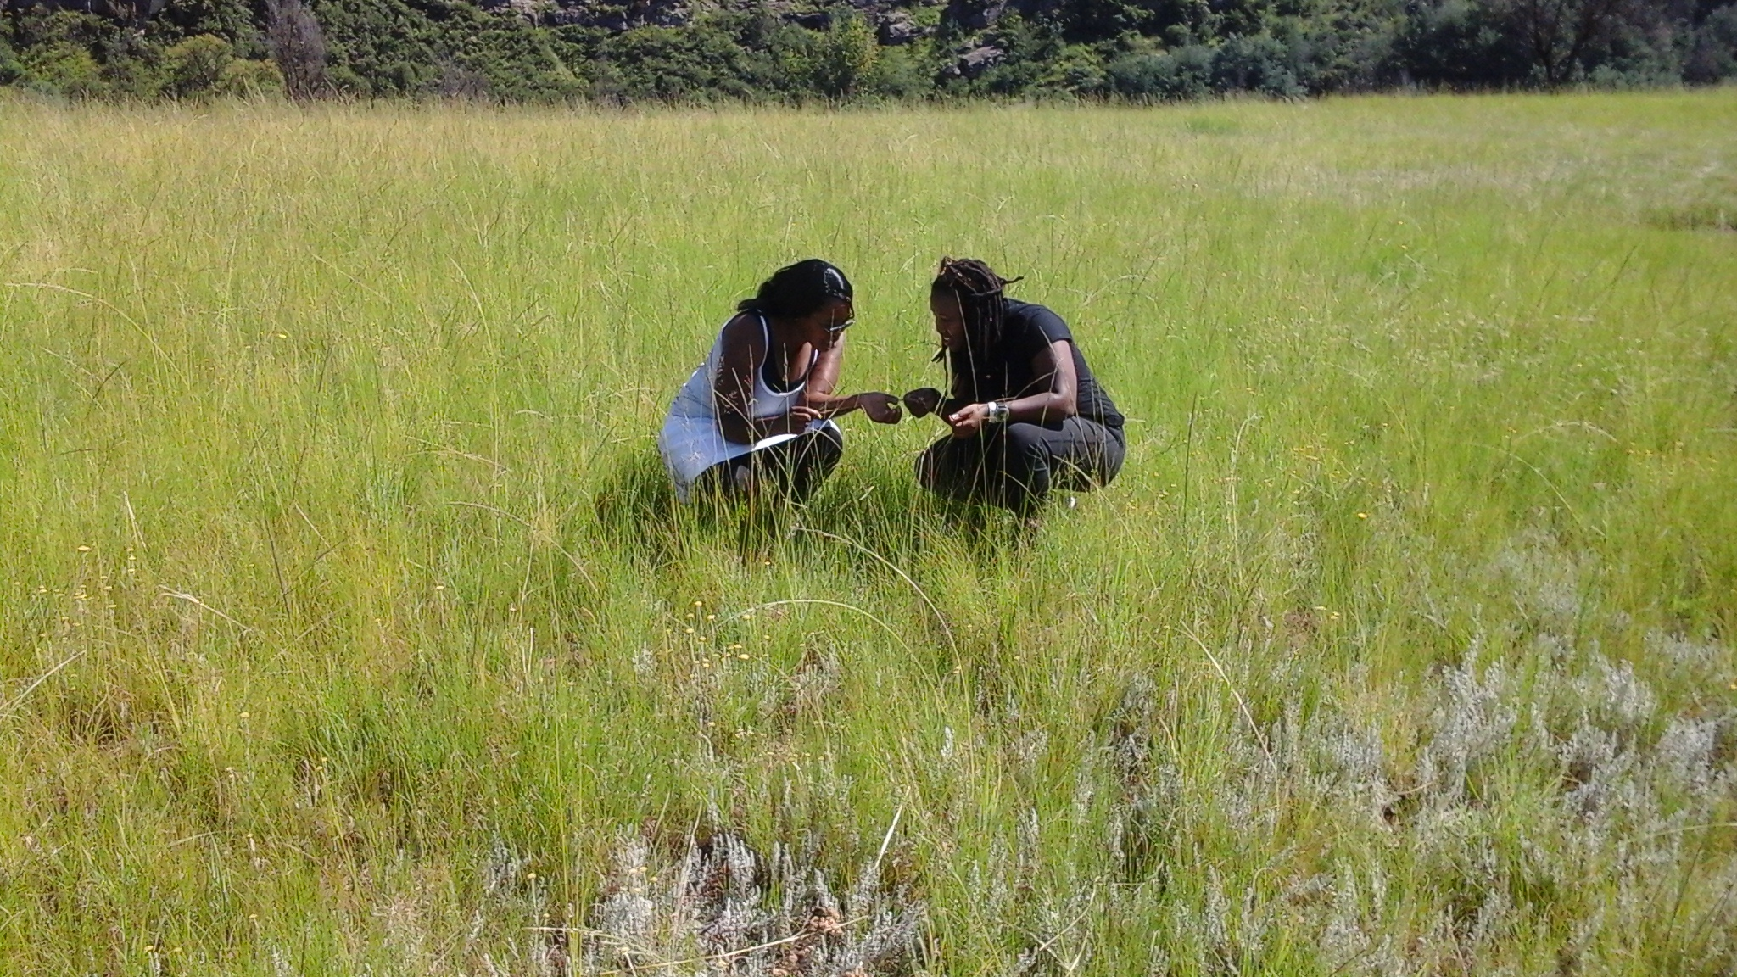
Research hypothesis
Rotational grazing, compared to continuous will result in greater plant biomass accumulation and thus less soil erosion and runoff;
Rotational grazing will result in moderate bioturbation compared to continuous grazing and hence better water infiltration and less soil compaction.

Slide 6
Research Design
The research methodology used quantitative methods.
The sites that were used were burnt sites over two years ago ( Hydrophobicity tests conducted)
Soil samples collected to measure soil organic matter and texture ( which impacts on erosiveness of soils).
Data collected twice, dry and wet season

Slide 7
Data collection
Dry & Wet Season
Infiltration measurements measured : Mini Disk Infiltrometer
Soil Samples Collected : Lab work conducted ( Soil organic matter and texture )
Hydrophobity tests were conducted to measure the carbon due to the fire on the soil
Biomass measurements were conducted using the disk pasture meter

Slide 8
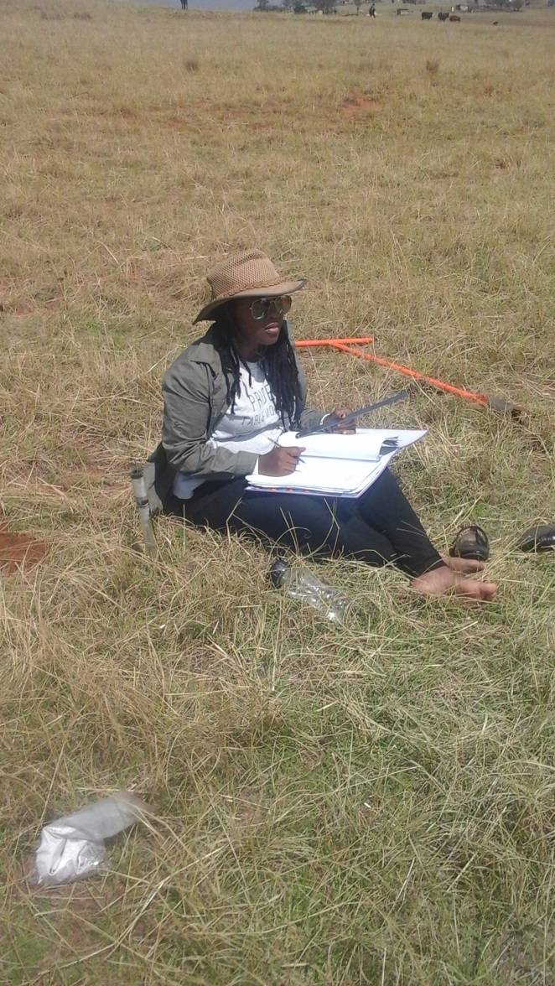
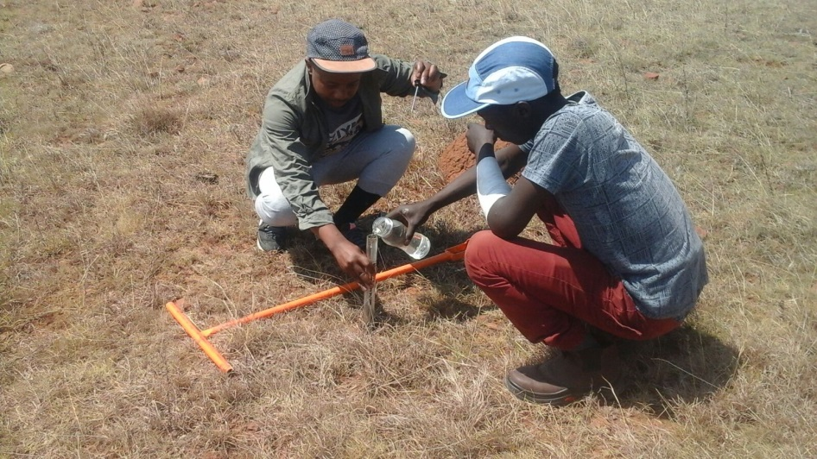
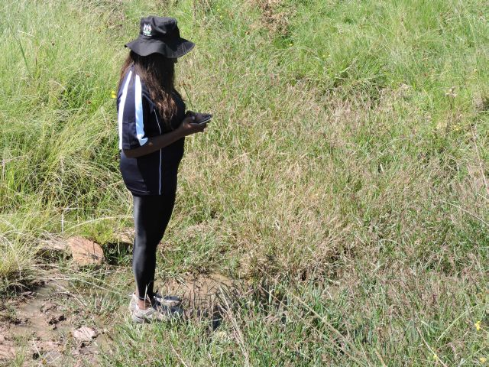
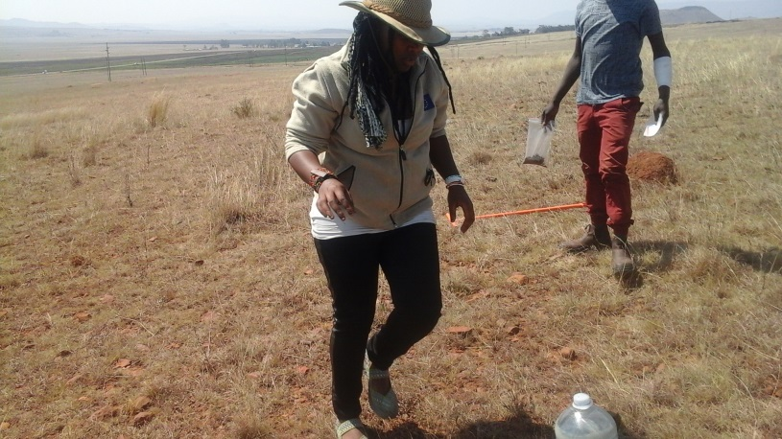
We look cool regardless!!!

Slide 9
hyperlink
Soil Organic Matter lab work\loi.xlsx
Infiltration data sheet Infiltrometer data sheet.docx
Hydrophobicity tests lab work\hydrophob ity\Book1.xlsx

Slide 10
Thesis First draft submission: 30 July
Final draft: September 2016
November 2016

Slide 11
Special Thanks
GreenMatter, Conservation SA & Partners, University of Western Cape

