Slide 1
Effects of Holistic Planned Grazing compared to continuous and four-camp systems on animal production.
By
RAPIYA MONDE
Supervisor: Dr. C. Mapiye
Co-Supervisors: Prof. V. Muchenje, & Prof J. Mupangwa

Slide 2
Introduction
Rangeland?
Rangelands occupy 70% of land in South Africa.
  Mostly used in rural areas for livestock production.
Nearly 4.8% of communal rangelands in South Africa are recognized as degraded.
Rangeland degradation is defined as a decrease in plant species diversity.
The main causes of Rangeland degradation
  Conversion of rangeland to cropland is the leading cause.
  Wood harvesting.
  Over-grazing by livestock.
  Climate change.

Slide 3
Restoration techniques.
Grazing exclusion.
Rotational grazing systems.
Balance between livestock numbers and the forage.
Irrigation, fertilising, surface tillage.
Traditional management has assumed an equilibrium system.

Slide 4
Conti…
Grazing management is a powerful tool which influence livestock production and forage availability.
Importance of grazing management systems(GMS).
  GMS are used to exploit rangeland through grazing.
  GMS are used for evaluating and managing rangeland
  They play a vital part in the value & extent of animal production.
  GMS are also used to controlling livestock grazing to come out with specific outputs.

Slide 5
Grazing systems used in South Africa.
Rotational grazing
Continuous grazing
Holistic Planned grazing
Rotational and continuous grazing systems are the most affordable management practices.
These grazing systems were reported as the main cause of a decrease in the value of rangeland.

Slide 6
Conti..
Holistic planned grazing (HPG) is an intellectual method of managing and re-establish resources that were initially developed.
Holistic planned grazing is similar to rotational grazing since it is a short grazing method.
HPG Differ from RG since it gives a background of adapting ecosystems while rotational grazing use already available resources.
HPG method can be practiced in rangeland with several ecological factors and is also associated with a permaculture method to range management.

Slide 7
General Objective
To investigate the effects of Holistic Planned Grazing (HPG) management system compare continuous and rotational grazing on animal performance.

Slide 8
Specific Objectives
To compare the effects of HPG, continuous grazing and 4-camp rotational grazing systems on animal growth and carcass attributes.
To compare the effects of HPG, continuous grazing and 4-camp rotational grazing systems on tick loads.

Slide 9
  Hypothesis
HPG, continuous grazing and 4-Camp rotational grazing systems have no effect on animal growth and carcass attributes
HPG, continuous grazing and 4-Camp rotational grazing systems do not have an influence on tick loads

Slide 10
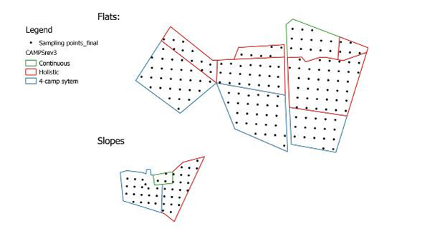
Materials and Methods
Study site

Slide 11
Experimental Design
The farm will be randomly divided into three sections, each treated with a different management practice.
Animals will be divided into three groups.
Animals will be placed and allowed to graze for a season on each short grazing system and continuous grazing.
Animals will allow seven days rest under HPG and RG while under continuous grazing system animals will graze for the entire season without resting.

Slide 12
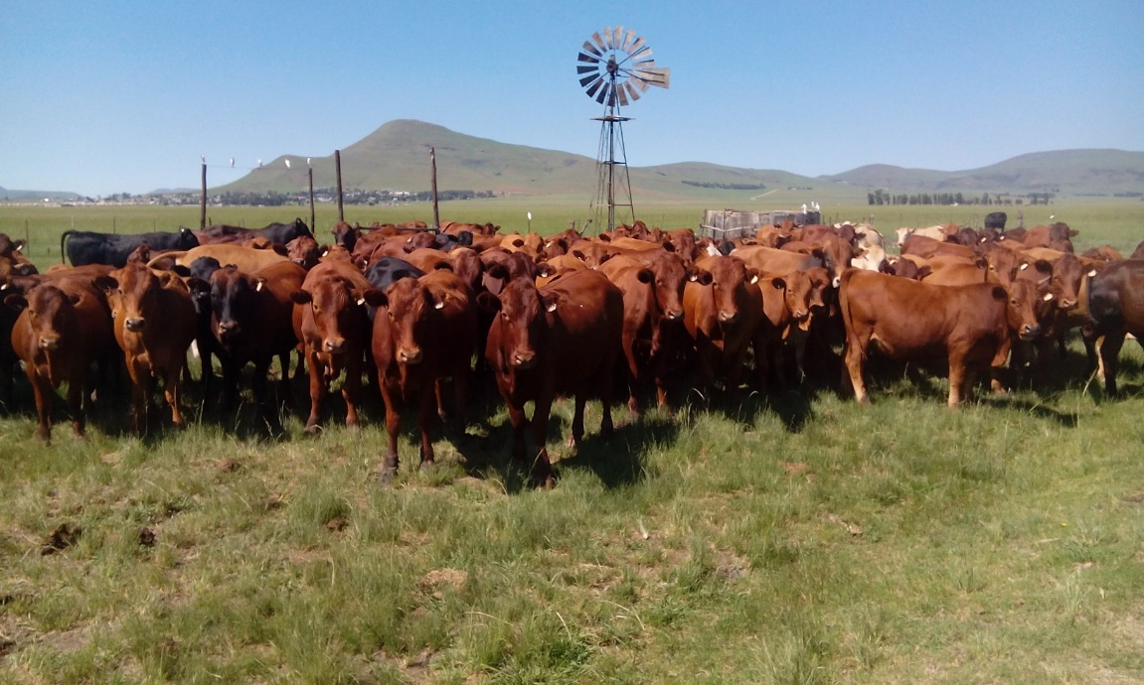
Conti..
110 Oxe weaners (mixed Bonsmara, Simmentaler and Boran).

Slide 13
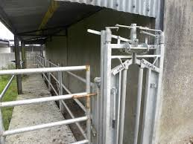
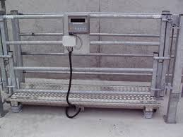
Data collection.
Mobile Race

Slide 14
Carcass Attributes
Animals will be transported to slaughterhouse around Mzimvubu and wait 2hours lairage.
Animals will weigh before slaughter to measure Live weight of each cattle.
Fresh and cold weight of the carcass will measured in order to evaluate dress percentage.

Slide 15
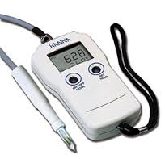
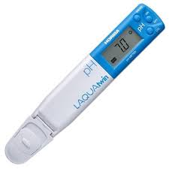
Minolta colour-guide and pH meter

Slide 16
Conti….
The following formula will be used to calculate final weight (final/Actual weight = hot weight/average dressing percentage*100).
Skin, head, empty stomachs, and empty intestines will be weighed as non carcass parts.

Slide 17
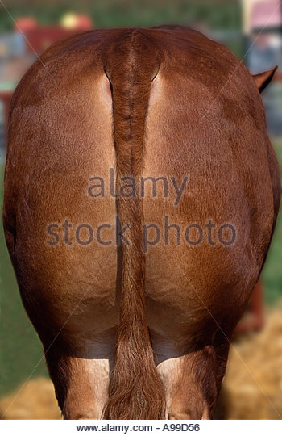
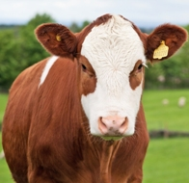
Tick collection

Slide 18
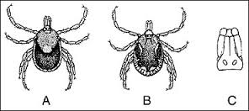
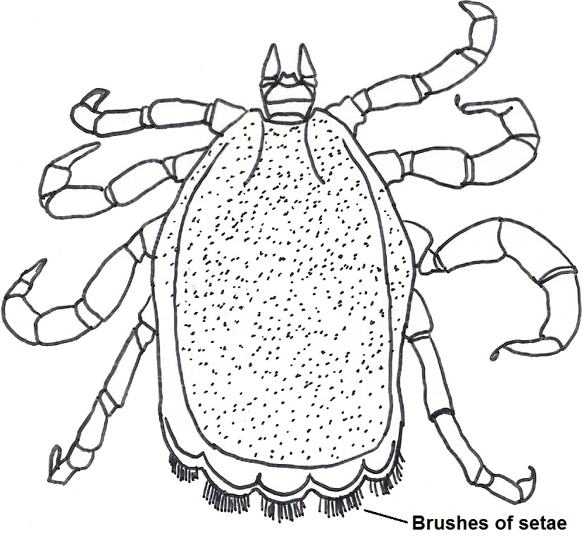
Tick identification

Slide 19
Statistical analyses
Data will be analysed using the general linear model (GLM) procedures of Statistical Analysis Systems (SAS/JMP, 2013).
Y_{ijk} = µ + T_{i} + L_{j} +S_{l}+(T x L)+(T x S)+(L +S) _{ijk} +e_{ijk}
µ = Mean,
T = effects of grazing management systems.
L = Effect of live weight
S = effect of season
e_{ijk =} Standard Error

Slide 20
Expected outcome
The study will come out with clear knowledge and understanding of animal production under different grazing systems.
Animals under short grazing systems are expected to perform better than those under continuous grazing.

Slide 21
Work Plan
Activities 2016-2017 | Mar – May | June | Jul | Aug | Sept | Nov | Dec - Fer | Mar – Jun | Jul | Aug | Sept
Proposal Write-up & presentation | X
Data collection |  | X | X | X | X | X | X | X
Literature Review |  |  | X | X | X | X
Data Analysis and Thesis Write up |  |  |  |  |  |  |  | X | X | X
Thesis Write up |  |  |  |  |  |  |  |  |  |  | X

Slide 22
End
THANK YOU….

