Slide 1
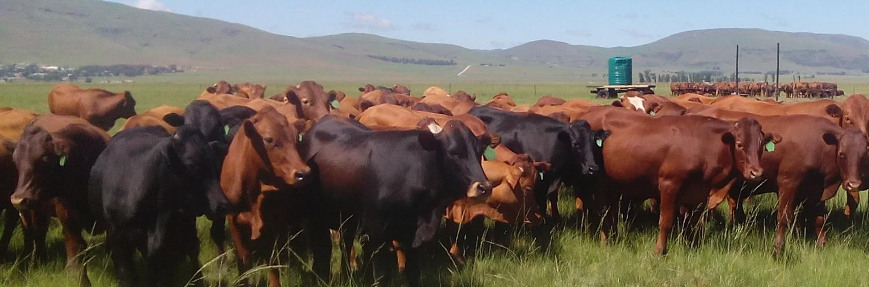







Update: The Holistic Planned Grazing project
Nompendulo Mgwali, Nolu Kwayimani, Zander Venter, Vanessa van Niekerk, Monde Rapiye, Michelle Ward, Susanne Vetter, Michael Cramer, John Mupangwe, Cletos Mapiya, Voster Muchenje, Elmi Lotze, Peter Scarth, Stuart Phinn, Michael Grenfell, Heidi-J Hawkins
Sept 20, 2016
UCPP Research Group meeting

Slide 2
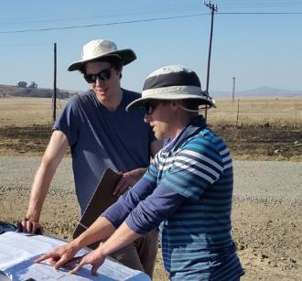
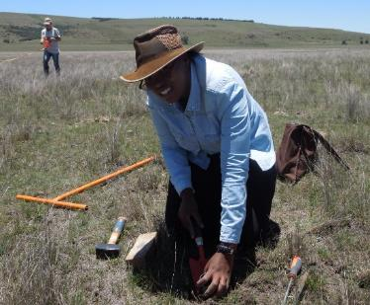
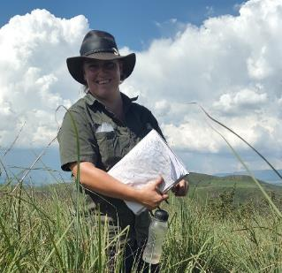
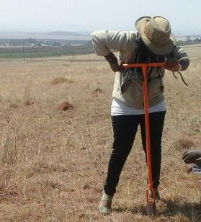
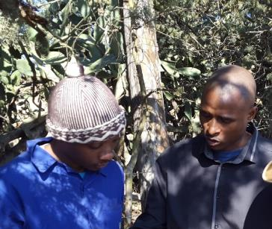
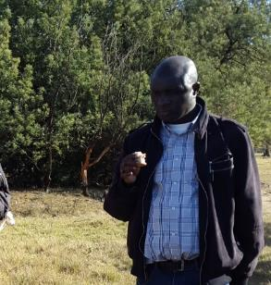
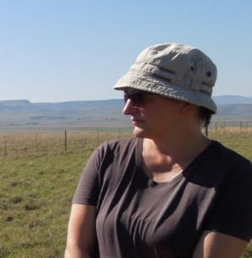
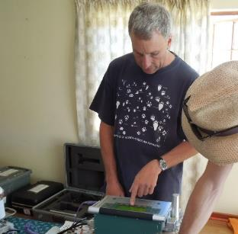

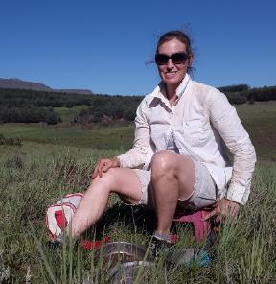
Research Group & contributors

Slide 3
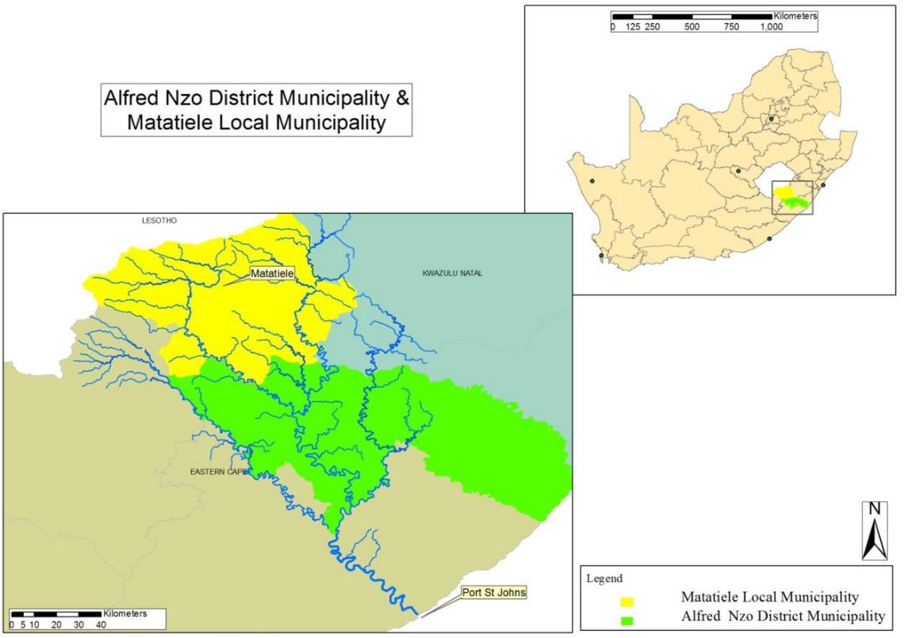
uMzimvubu: Water & grazing ecosystem services under threat
Notes:
Rationale: As we all know the Mzimvubu has conservation value for its water and grazing ecosystem services

Slide 4
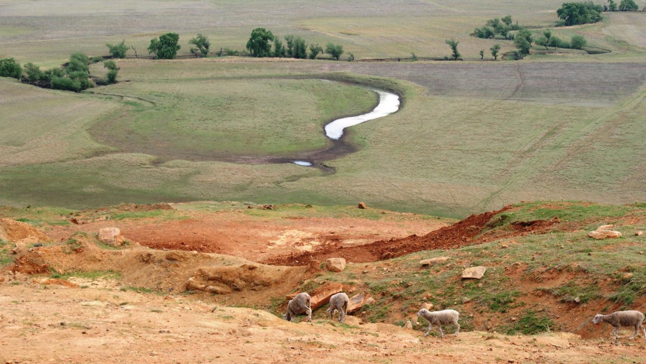
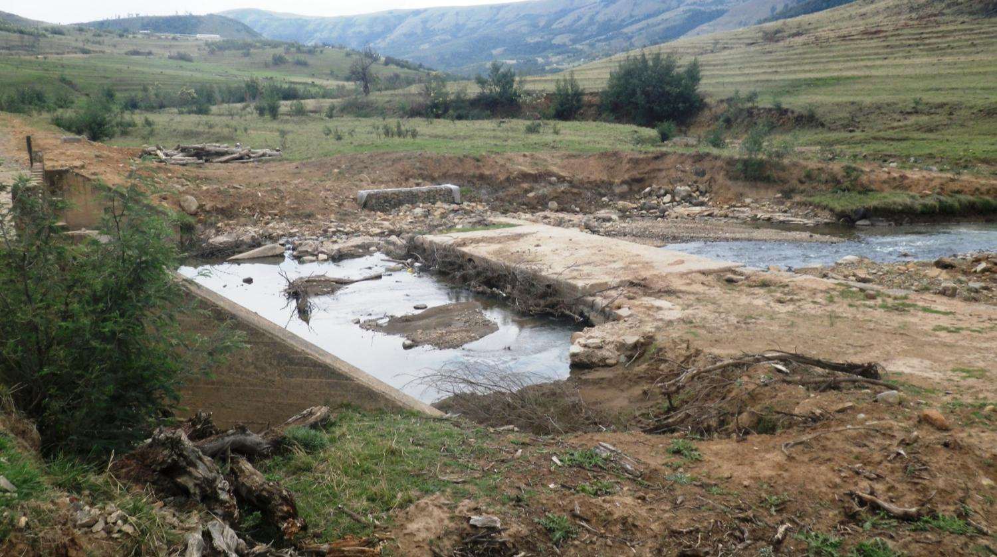
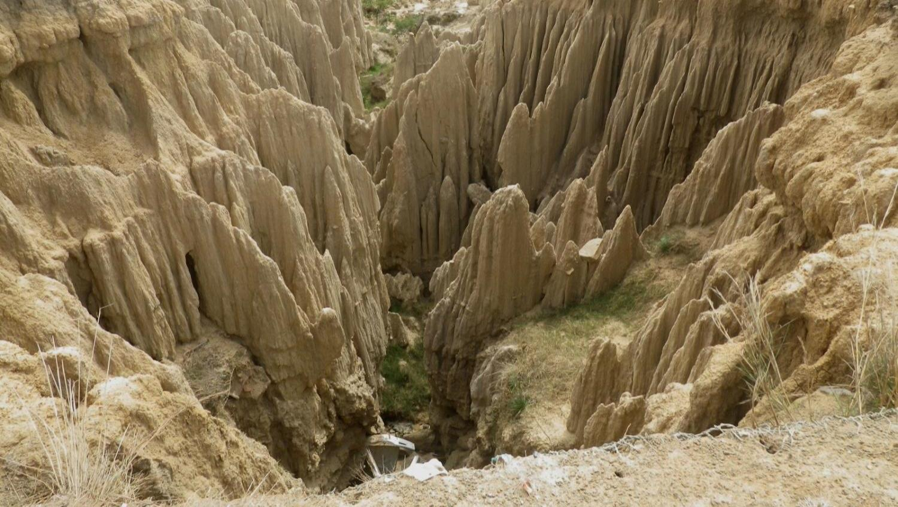
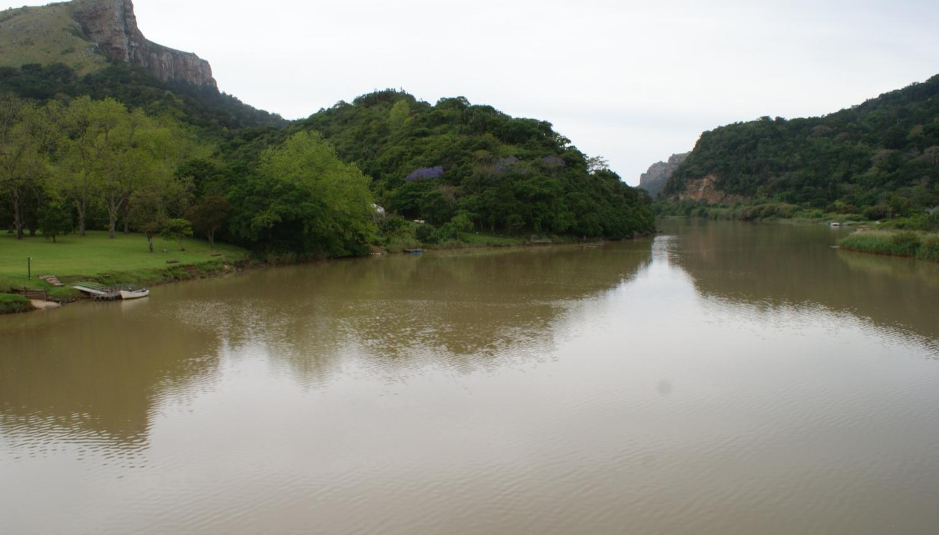
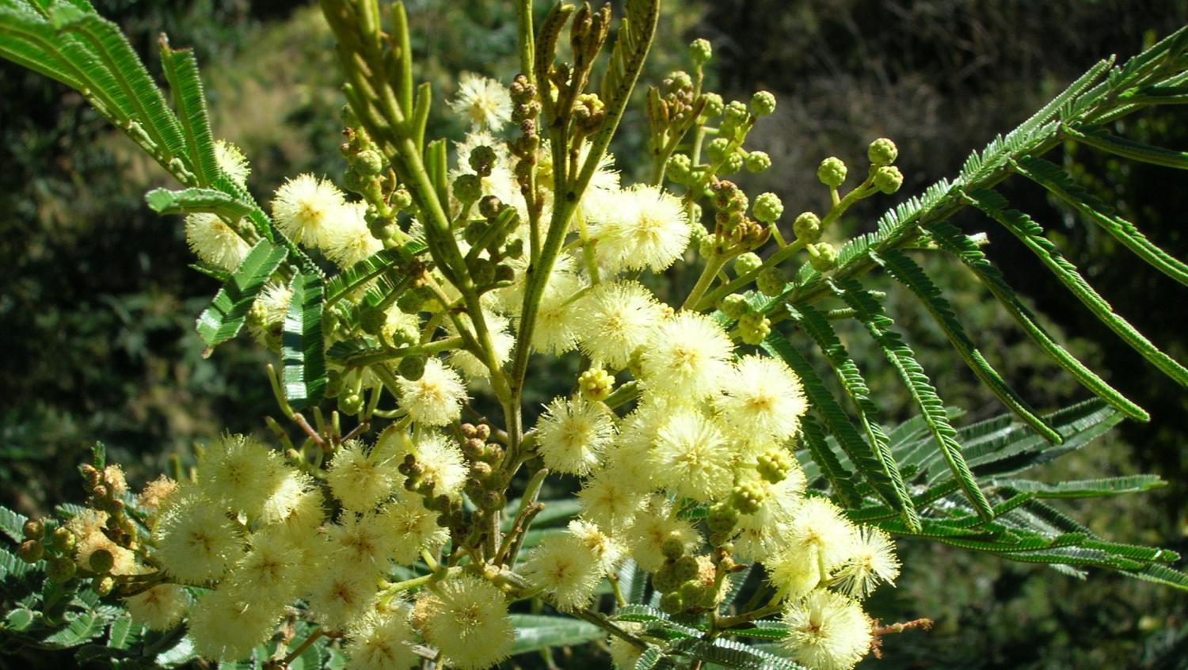
Land use pressures identified by communities, NGOs and government
Notes:
But we are all aware of the land use pressures from overgrazing, poor infrastructure, erosion, ultimately siltation and loss of water services (flip through pictures)

Slide 5
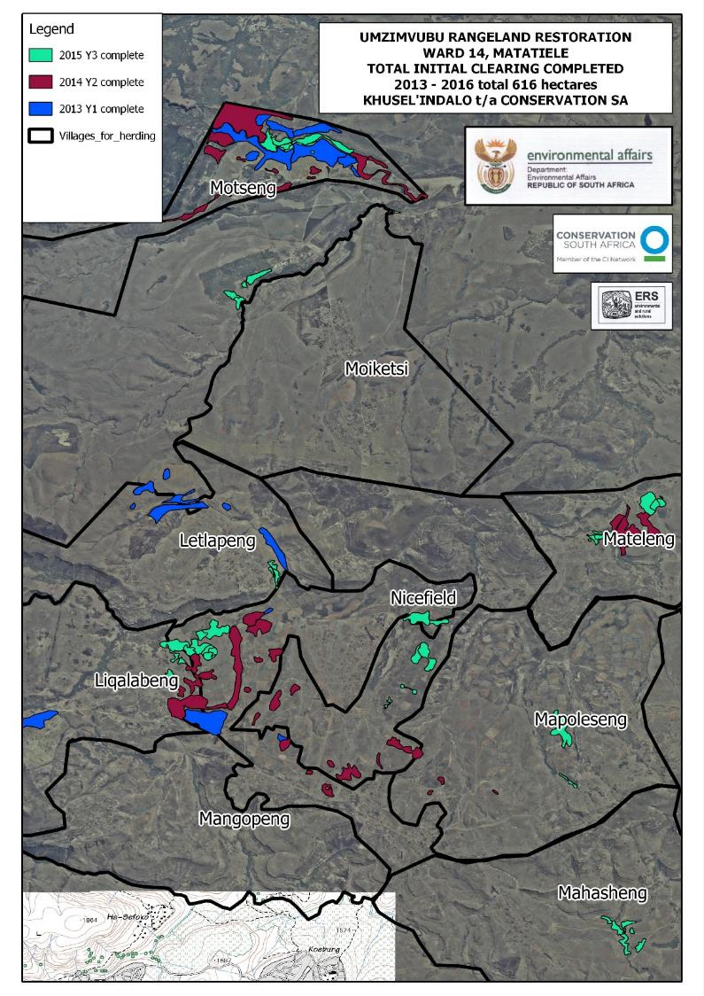
Natural Resource Management
Activites:
AIP clearing
Planned grazing /herders
Mabuela
Kraaling
Wards 7, 14, 21
Notes:
As a result CSA and ERS are implementing NRM projects in Wards 14, 7 and 21 where activities are alien plant clearing, planned grazing using herders, mabuela, and just kraaling.
Our research focusses on these three

Slide 6
Research feeds into
Communal landowner practices
Private landowner practices
Meat Naturally Pty
Notes:
so that we can give the best possible recommendations to communal and private farmers as well as feed into a social enterprise called Meat Naturally (various services such as training, ear tagging, market access)

Slide 7
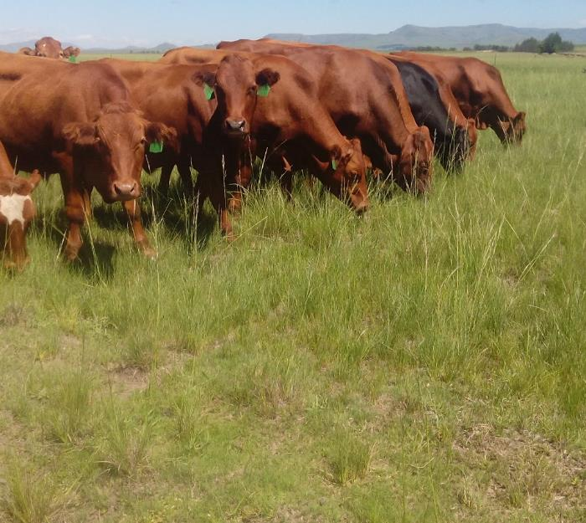
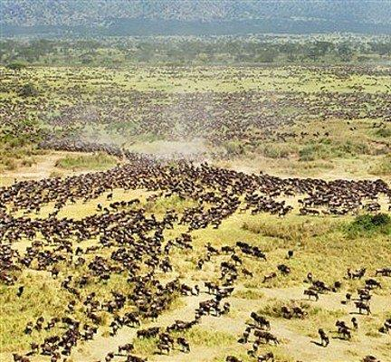
Holistic Planned Grazing and similar intensive approaches advocate high livestock densities and long recovery periods and assume this mimics natural behavior (e.g. migration)

Slide 8
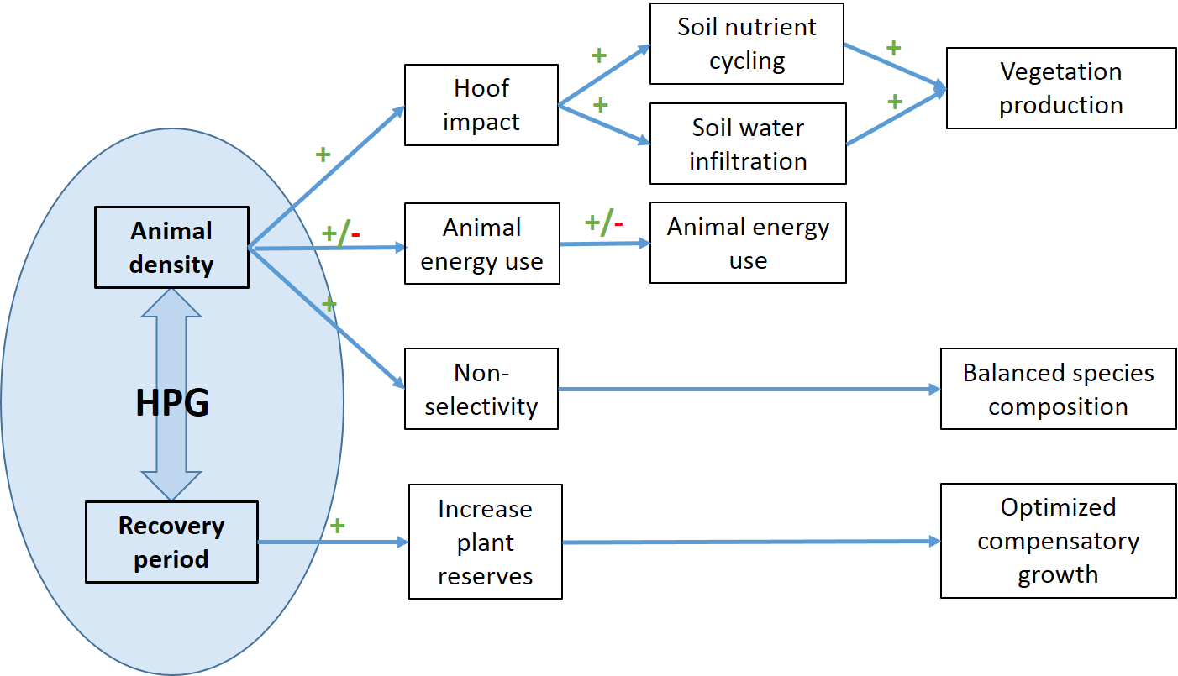
Diagram summarising the mechanisms by which Holistic Planned Grazing is claimed to benefit overall rangeland productivity.

Slide 9
The HPG research group
A global review¹ showed that intensive grazing makes no difference to production but possibly reduces selective grazing depending on the climatic area
Thus our research addresses gaps:
  If and how HPG increases forage utilization
  Effects on soil hydrology, carbon, biodiversity
  Usefulness as a restoration tool
  Effect across a climate gradient
1 Hawkins H-J 2016 Does intensive grazing work in native rangelands. African J Range and Forage Science (submitted)

Slide 10
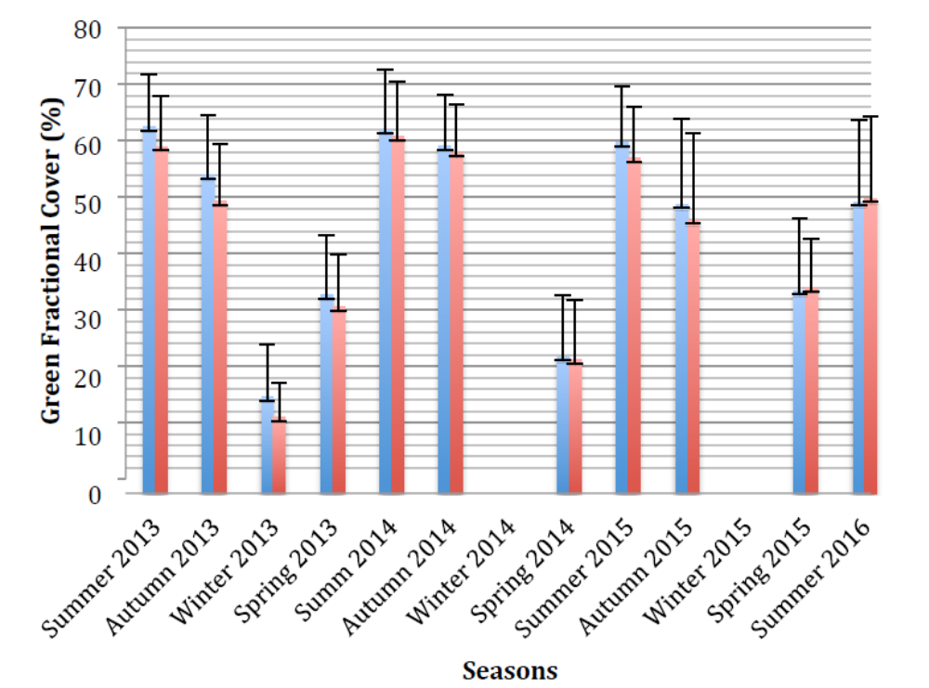
Main results so far: communal lands
Motseng: HPG
Moiketsi: Cont.
Michelle Ward, MSc.
University of Queensland
Notes:
Michelle made a geospatial analysis comparing Motseng (practicing holistic grazing from 2013 to 2015) and Moiketsi (continuous grazing) in Ward 14. There were no significant differences in green and brown fractional cover (soil cover) and no differences in NDVI during the study period. This was to be expected given the short time period of the study. However, the movement of animals to grazing lands, as well as dipping and animal husbandry resulted in increased animal gains in the holistic herd, with many animals being sold on auction as part of the Meat Naturally initiative.

Slide 11
Main results so far: communal lands
Nompendulo Mgwali, MSc.
Rhodes University
Notes:
In ward 21 sites no difference yet but in ward 14 there is a bit of difference in trampled (inside) and untrampled (outside)

Slide 12
Main results so far: experimental farm
p = 0.747891
Vanessa van Niekerk, MSc.
Stellenbosch University
Notes:
Concerning the effect of trampling on soil infiltration: after 6 months Vanessa found there was no difference between the treatments, but we will see how this looks after 3 years.

Slide 13
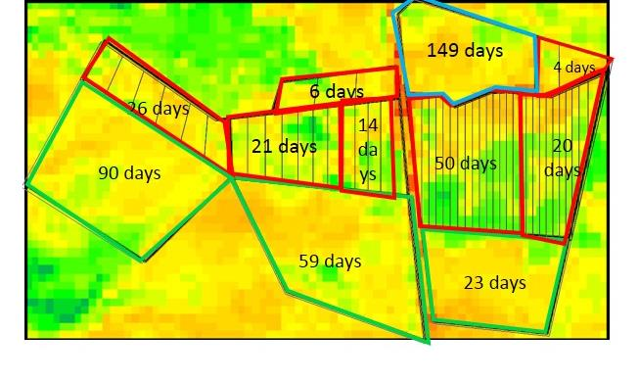
Main results so far: experimental farm
Continuous grazing
Holistic grazing
4-camp grazing
De-trended NDVI values for Merino Walk after each treatment had undergone the same number of grazing days: more standing biomass left after the growing season with holistic grazing – reason?
Zander Venter, PhD.
University of Cape Town
Notes:
Why is there more standing biomass left with holistic grazing? We are not sure but it may be that the long recovery periods in HPG allow forage to accumulate, including unpalatable biomass.

Slide 14
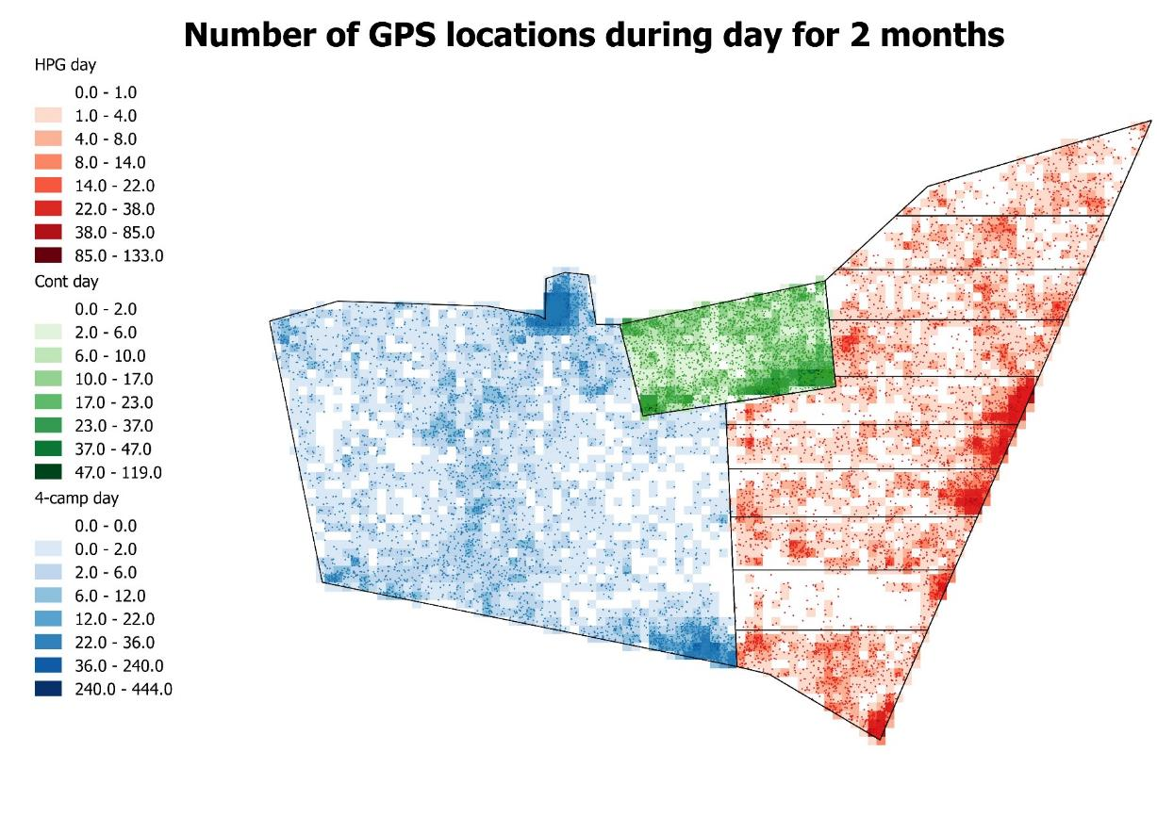
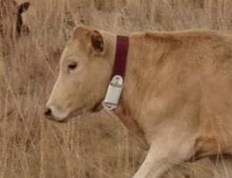
Results so far: experimental farm
Zander Venter, PhD.
University of Cape Town
Notes:
If we look at the GPS locations of cattle on HPG, continuous and 4-camp systems – at first glance, there does not appear to be differences in utilization of forage but we still have to look at this more closely using various calculations, as well as veg measurements.

Slide 15
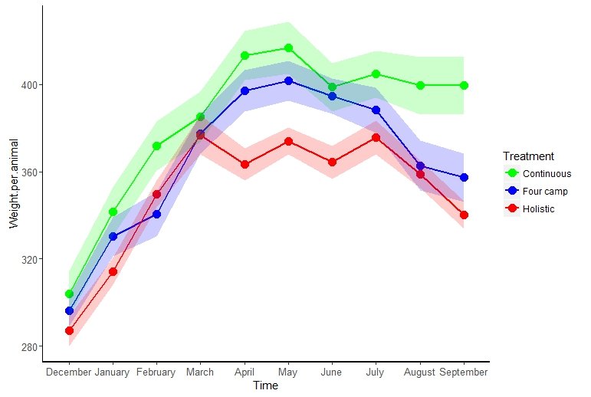
Results so far: experimental farm
Zander Venter, PhD.
University of Cape Town
Notes:
What is clear is the holistic herd is starting to lose weight compared to the continuous herd (at moment no statistical difference between holistic and 4-camp weights). Is this because high animal densities prevent them from selecting higher quality forage; or maybe they are expending more enegy by walking between camps every day. We hope to be able to tell you more next time.

Slide 16
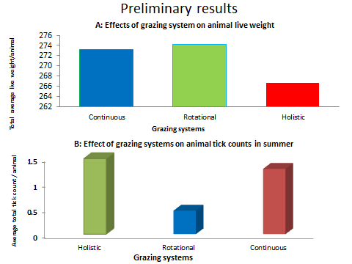
Results so far: experimental farm
Monde Rapiye, MSc.
University of Fort Hare
Notes:
What is clear is the holistic herd is starting to lose weight compared to the continuous herd (at moment no statistical difference between holistic and 4-camp weights). Is this because high animal densities prevent them from selecting higher quality forage; or maybe they are expending more enegy by walking between camps every day. We hope to be able to tell you more next time.

Slide 17

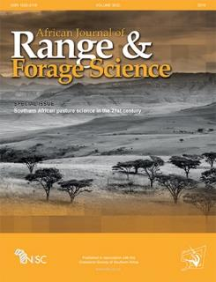
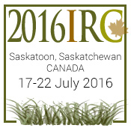
Communication
2 student posters at 51st GSSA, Wilderness
Project lead invited to be Editor in Chief for special edition on holistic grazing
1 global review presentation at International Rangeland Conference, Saskatoon, Canada
3 articles in Farmers Weekly
1 global review article submitted to African Journal of Range and Forage Science

Slide 18
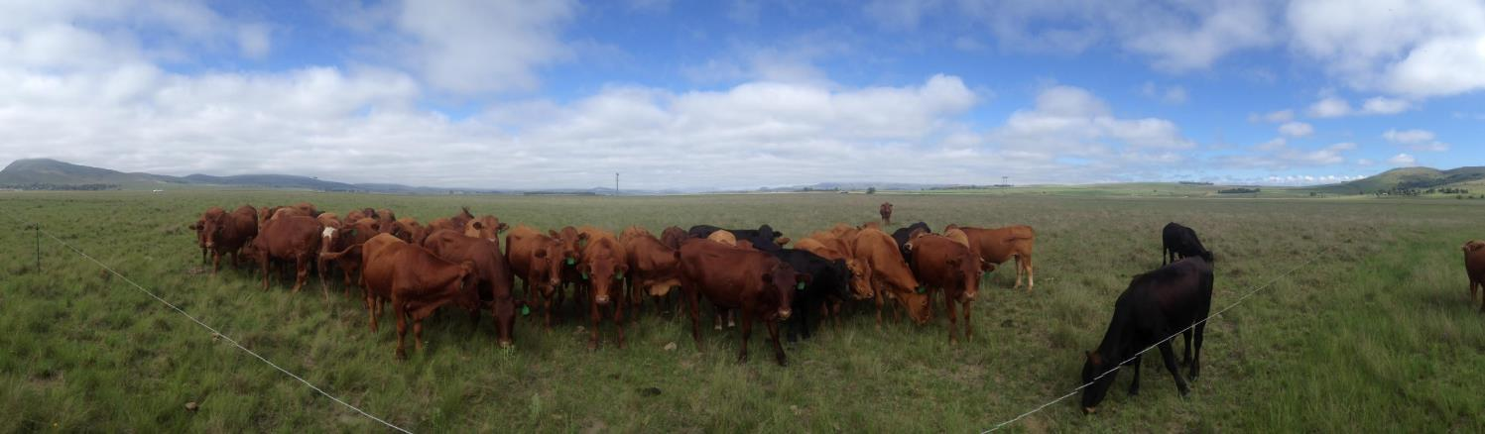



Acknowledgements to funders and whole research group

Slide 19
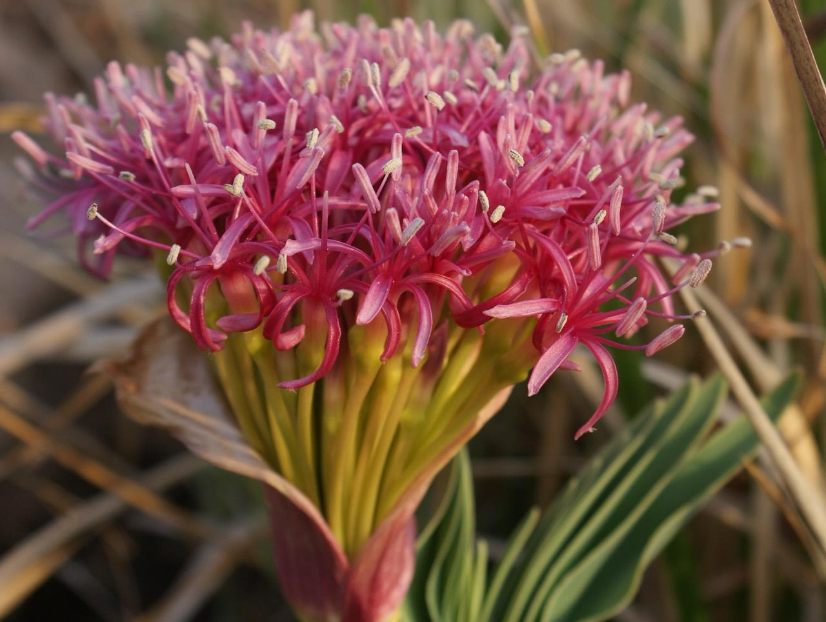


Questions?
More info: Heidi Hawkins
hhawkins@conservation.org
heidi-jane.hawkins@uct.ac.za
Cell: +27 744790609
@ariseoharjuna

