Slide 1


The role of herbivore exclusion on the ecosystem function in Mount Fletcher, Eastern Cape, South Arica
Nandipha G. Ndamane, Mathieu Rouget,
Jorge L. Renteria, Ayanda Sigwela

Slide 2
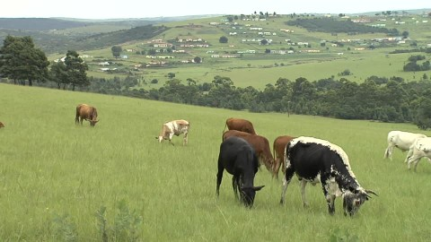
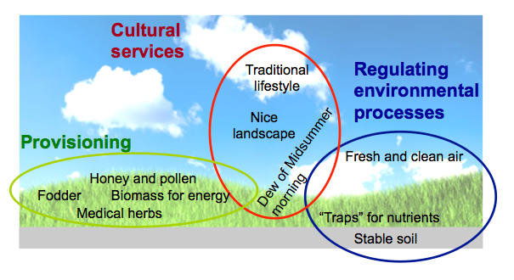
Introduction
Grazing exclusion is considered as effective grassland management practice that aimed to:
  Prevent grassland degradation
  Retain grassland ecosystem function

Slide 3
Hypothesis
Livestock exclusion will enable vegetation to recover and attenuate soil loss by erosion
Objective
The effects of continuous grazing and exclusion of livestock on ecosystem function
By measuring the changes in vegetation cover and ecosystem functioning using the landscape function analysis (LFA) method

Slide 4
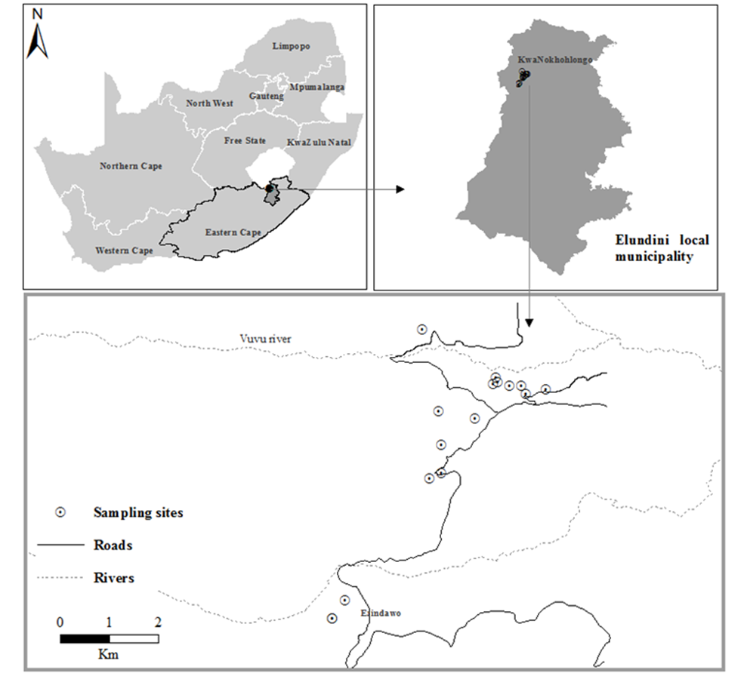
Study area

Slide 5
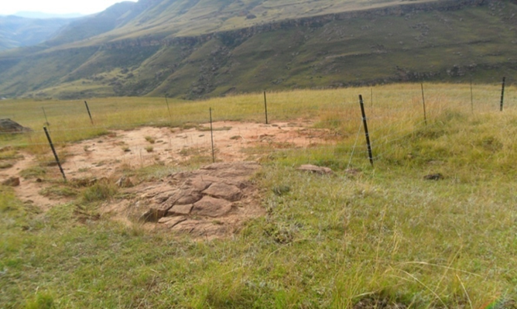
Study area

Slide 6
Methodology
Landscape function analysis (LFA)- assesses how well an ecosystem functions using visually assessed indicators
LFA is divided in two components:
  Landscape organization
  Soil surface assessment

Slide 7
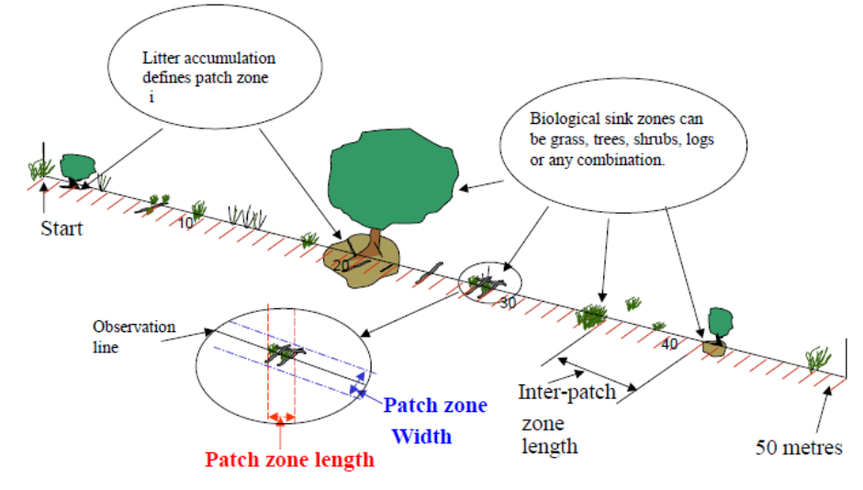
Landscape organization
Tongway, D. J. & Hindley, N. L. 2004. Landscape function analysis: Procedure for monitoring and assessing landscape

Slide 8
Soil surface assessment
Indicator | Process addressed | Stability | Infiltration | Nutrient cycling
1. Soil Cover/ Rain splash Protection | Indicates how well soil surface is protected from the impact of rain drops, which influences erosion and crust formation. | ✓
2. Perennial vegetation cover | Estimate basal cover of perennial grasses and canopy cover of trees/shrubs |  | ✓ | ✓
3. Litter, origin, degree of composition | Has strong influence on soil stability and nutrient cycling. | ✓ | ✓ | ✓
4. Cryptogam cover | The presence of algae, fungi, mosses, on the soil surface indicate soil stability and nutrient cycling. | ✓ |  | ✓
5. Crust brokenness | Broken crust indicate innately unstable surfaces. | ✓
6. Soil erosion, type and severity | Indicate nature of soil erosion and the severity. | ✓
7. Deposited material | Indicate instability or stability of upslope. | ✓
8. Soil surface roughness | Assess surface roughness for ability to retain and capture mobile resources |  | ✓ | ✓
9. Surface resistance to disturbance | Effect of mechanical disturbance | ✓
10. Slake test | Soil stability when subject to rapid wetting | ✓ | ✓
11. Soil surface texture | Classifies soil texture, which influences permeability. |  | ✓

Slide 9
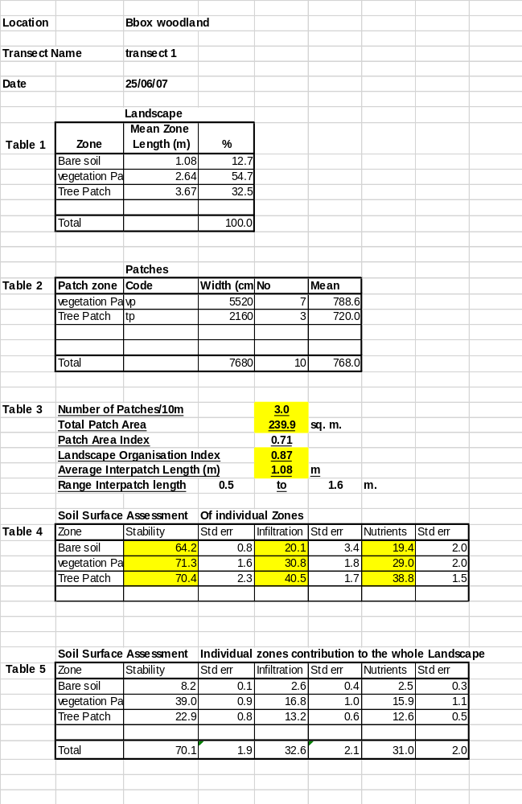
Data analysis
Landscape organization indices:
  landscape organization index,
  average inter-patch,
  total patch area,
  number of patches per 10m
SSA indices:
  stability,
  infiltration and,
  nutrient cycling

Slide 10
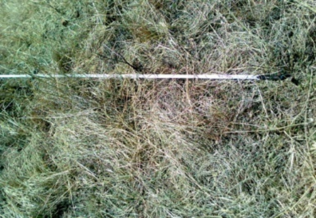
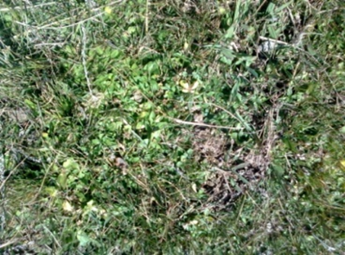
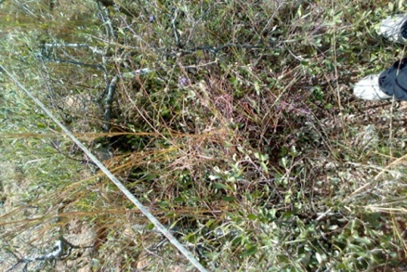
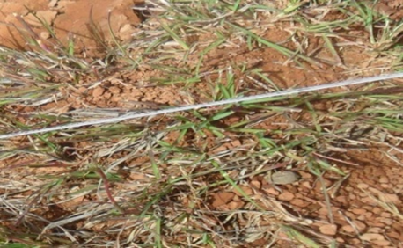
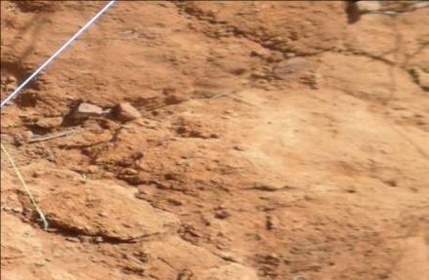
Landscape organization
Grass patch (GP)
Grass forb patch (GFP)
Grass shrub patch (GSP)
Sparse grass patch (SPG)
Bare soil (BS)

Slide 11
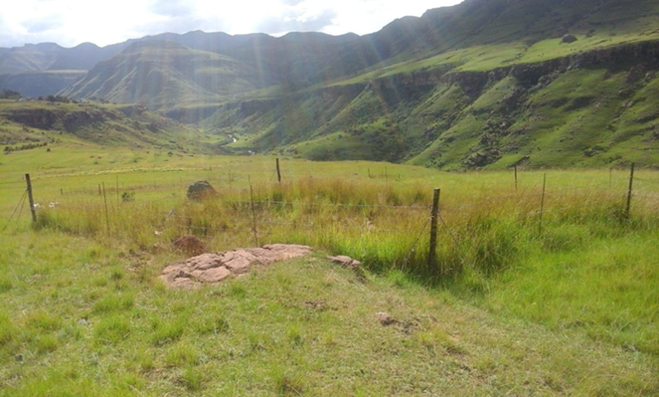
Results
Exclosure plot 2012
Exclosure plots 2015

Slide 12
Landscape organization

Slide 13
Soil surface assessment

Slide 14
Results
2012
2015
Average change
Average change

Slide 15
Discussion
The increased ground cover following exclusion of livestock effectively protected soil from loss by wind erosion
Response of vegetation cover to grazing exclusion varied between patches and inter-patches

Slide 16
Discussion
Fencing exclusion resulted in an increase in the vegetation cover
High retention of soil moisture
Improved stability
Enhanced infiltration
Improved nutrient cycling

Slide 17
Conclusion
These results demonstrated that grazing exclusion is an effective measure for:
  Maintaining the ecosystem functioning
  Improving above ground cover in the exclosure plots

Slide 18
Acknowledgments
NRF Chair – Mathieu Rouget
University KwaZulu-Natal
Sigwela and Associates Environmental consultant
Mount Fletcher

