Slide 1
Integrated Farm Planning Training
Endangered Wildlife Trust (EWT)

Slide 2
What is Integrated Farm Planning Training
Endangered Wildlife Trust (EWT) conducted an Integrated Farm Planning and Management training course in Cedarville, a vital area for cranes. The training took place at the local hall and community commonage
Integrated farming is defined as a biologically merged system, which combines natural resources management in a regulated mechanism for farming activities.
This is to enable farmers to practice environmentally sustainability and good economics, through better natural resource management.

Slide 3
Integrated Farm Planning Training
EWT/ICF work is engaging with communities to play an active role in managing their immediate environment.
This entails implementing projects and facilitating trainings of participating communities to encourage members on sustainable use of natural resources.

Slide 4
Integrated Farm Planning Training
It aims to upskill the emerging farmers to be able to stimulate their own grazing management plan based on their farm challenges. Knowledge acquired from the training, helps the emerging farmers to understand the importance of species diversity in their grazing veld and it’s grazing capacity per unit stock.

Slide 5
Participation during IFP training
Twenty emerging farmers were invited but we ended up hosting 34 farmers with an additional 14 interested farmers joining. Other attendees included Asanda Ndaba from the Department of Agriculture, Wayne McNamara from the Underberg Farmers Association and Mr Luthuli as the ward councilor.

Slide 6
Factors affecting veld condition in Cedarville
Veld type, time of the year and drought beyond farmer's control.
In Cedarville factors influenced by management were predominant, factors like selective grazing, livestock ratios, quality, quantity and height of herbage.

Slide 7
Suggested Grazing Management Strategies
Grazing management can influence each of the above factors and subsequently have a profound effect on animal performance
Veld condition Assessment procedure
Control stocking rate
Dividing area into camps
Adequate period of stay in a camp
Managing system, grazing cycle and period of absence
Supplementary feeding
Veld burning

Slide 8
In Conclusion
As an organization our role during the training was to help the emerging farmers to understand their landscape and farms, the importance of species diversity, fire and, resting of their veld.
This training is being extended into two other communities we are currently partnered with. In addition, the organization is organizing community exchange visit with Black Diamond community that faced the same problems as Cedarville.
.

Slide 9
Conclusion
In this visit, Black Diamond community will show Cedarville farmers practical projects on rangeland management, as well as information on livestock management.
They used mechanisms that helped them to improve their grazing and land management. We are looking forward to see changes in their grazing and land management as well as the improvement in crane habitat

Slide 10
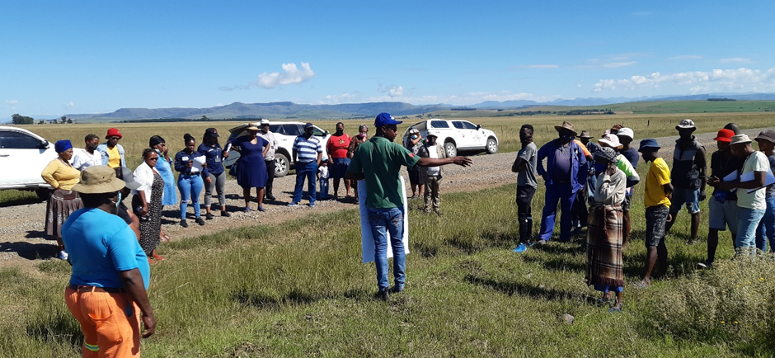
Photographs

Slide 11
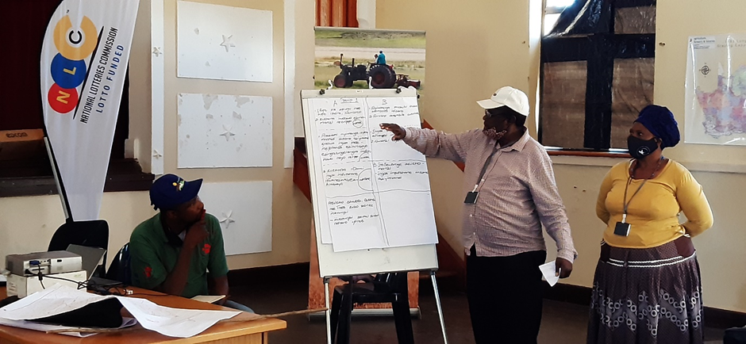
PHOTOGRAPHS

Slide 12
THE END.
HAPPY BIRTHDAY TO SAMSON PHAKATHI

